Slide 1
2015-21 Division II Strategic Plan
Template for Institutional/Conference Use

Slide 2
In April 2015, the Division II Presidents Council formally approved a six-year strategic plan that builds upon the division’s unique attributes to help institutions and conferences promote themselves.

Slide 3
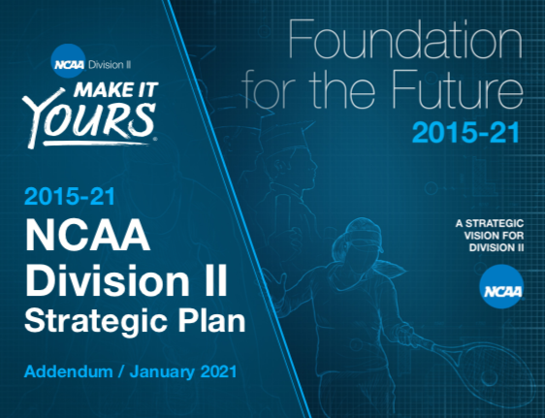
In 2020, the Council agreed to extend the plan through 2023 to align with the next Division II Membership Census and the beginning of the next phase of the NCAA’s broadcast agreement.
In the interim, the division published an addendum to summarize accomplishments to date (the addendum is available at http://www.ncaa.org/governance/division-ii-strategic-plan).

Slide 4
The plan includes five Strategic Positioning Outcome Areas to address in the coming years:
Academics and Life Skills
Athletics Operations and Compliance
Diversity and Inclusion
Game Day and Conference and National Championships
Membership and Positioning Initiatives

Slide 5
Strategic-Positioning Outcome Area No. 1: Academics and Life Skills
Primary goals: Produce student-athletes who graduate, who exhibit leadership, who engage with their communities, and who have acquired the skills they need to maintain healthy and productive lifestyles.

Slide 6
Graduation Rates/ASR
Division II
Federal Rate
Student-Athletes
Overall 59% Men 52% Women 68%
Student Body
Overall 51% Men 46% Women 54%
Student Athlete ASR
Overall 74% Men 66% Women 87%
Institution/Conference
Federal Rate
Student-Athletes
Overall ?% Men ?% Women ?%
Student Body
Overall ?% Men ?% Women ?%
Student Athlete ASR
Overall ?% Men ?% Women ?%

Slide 7
Academic Success
Division II
Path-to-Graduation Toolkit (new resources online).
NCAA Postgraduate Scholarships.
Division II Degree-Completion Awards (additional funding allocated through Foundation for the Future).
Institution/Conference
Note use of toolkit and tout recipients of the NCAA awards, or list your own programs that help student-athletes earn their degrees.

Slide 8
Leadership Development
Division II
New SAAC super region conventions.
Student-Athlete Leadership Forum (annual gathering representing all Division II conferences).
Institution/Conference
Note your student-athletes who are members of the Division II governance structure or who have participated in the Leadership Forum or super region convention, or identify your own SAAC’s leadership efforts.

Slide 9
Community Engagement
Division II
Activities at every Division II championship finals site.
Division II Award of Excellence (annual recognition for engagement efforts).
Institution/Conference
Tout your own community engagement during the regular season or at conference championships
Promote Award of Excellence recognition, if applicable.
Use the Helper Helper app to track engagement.

Slide 10
Make-A-Wish
Division II
Since the Division II SAAC established the partnership in 2003, the division has raised more than $6 million for the nonprofit organization.
Those funds have been used to grant wishes to hundreds of kids across the country with life-threatening medical conditions.
Institution/Conference
Tout your own Make-A-Wish totals, or note other charitable engagement efforts your student-athletes have undertaken.

Slide 11
Health and Wellness
Division II
FAR Advocacy (new best practices for FARs to champion student-athlete mental health and wellness).
Independent Medical Care (2017 Convention proposal increased the decision-making authority for medical personnel on campus).
Institution/Conference
List your own programs/initiatives that help protect/enhance student-athlete health and wellness.

Slide 12
Strategic-Positioning Outcome Area No. 2: Athletics Operations and Compliance
Primary goals: Help Division II institutions and conferences create engaged and high-functioning athletics operations and compliance programs.

Slide 13
Athletics Operations
Division II
Convention/Governance Structure (presidents have the ultimate authority to oversee athletics).
FAR involvement (Division II conducts annual FAR Leadership Institutes).
Institution/Conference
List your representatives on DII governance and sport committees
Note how your FAR helps support your athletics program.

Slide 14
Compliance Operations
Division II
Division II University (new online educational platform for coaches and other stakeholders).
Coaches Connection (uses former coaches to help strengthen link between coaches associations and national office).
Regional Compliance Seminars (annual education for members).
Online Education Resource Center (new collection on NCAA.org).
Institution/Conference
Tout your interaction with these programs, or note other initiatives you’ve implemented to assist your compliance operations.

Slide 15
Strategic-Positioning Outcome Area No. 3: Diversity and Inclusion
Primary goals: Promote diverse and inclusive environments within all levels of intercollegiate athletics.

Slide 16
Create Diverse and Inclusive Environments
Division II
Presidential Pledge (new commitment to promoting diversity and gender equity in athletics).
Inclusion Forum/Leadership Institutes (annual NCAA programs to support inclusion).
Diversity Grants (for administrators and coaches).
Institution/Conference
Has your president/chancellor signed the pledge?
Note members who have attended the Inclusion Forum, and note positions you’ve created through grants, if applicable.

Slide 17
Strategic-Positioning Outcome Area No. 4: Game Day and Championships
Primary goals: Enhance the game day and championships experience for Division II student-athletes.

Slide 18
Game Day Experiences
Division II
Commitment to enhance game environment (lively, civil and entertaining).
Effort to bolster officiating processes and programs (register with ArbiterSports; training for conference coordinators, etc.).
Institution/Conference
Tout your own game environment efforts, as well as steps you’ve taken to improve officiating.

Slide 19
Championships Experiences
Division II
25 annual championships.
National Championships Festivals (multiple championships at a single site).
Institution/Conference
Highlight postseason accomplishments either at the conference level for schools or national level for schools and conferences; also note participation in recent festivals, if applicable.
If you’ve hosted an NCAA championship, celebrate it!

Slide 20
Strategic-Positioning Outcome Area No. 5: Membership and Positioning Initiatives
Primary goals: Foster fiscal responsibility at the local, conference, regional and national levels, continue to develop member institutions and conferences that support the strategic position and philosophy of Division II, and enhance the public’s knowledge and appreciation of Division II.

Slide 21
Make It Yours
Division II
Distinguishing Characteristics/Attributes (new effort to explain Division II to multiple audiences).
Institutional Performance Program (new resource for Division II members).
Conference Grant Program (ties to specific goals/areas).
Institution/Conference
Have you identified the characteristics/attributes that set your institution/conference apart from your competitors?
How do you use the IPP to your advantage?
What benefits result from your conference grant dollars?

Slide 22
Value of Athletics
Division II
Promote unique attributes such as the partial scholarship model to point out the value of athletics to institutions.
Continue to garner testimonials from student-athletes who succeed within the Make It Yours platform.
Institution/Conference
Tout student-athletes who have a story to tell under the “Make It Yours” theme.
Note recent alumni who have benefited from their participation in athletics to make a difference beyond the playing field.

