Slide 2
What is Division II?
Notes:
Note to presenters: This PowerPoint deck is an opportunity for you to explain Division II – and how your institution/conference fits as a member – to audiences that have varying familiarity with the NCAA’s three-division structure. You can tailor this presentation to accommodate all audiences – from those who know nothing about the NCAA or Division II (e.g., community groups, rotary clubs, potential donors, etc.) to those who know about the NCAA but perhaps not about what makes DII unique (e.g., faculty senates, alumni, administrators who join your institution/conference after having worked within another NCAA division). Keep the slides from the following deck that meet your specific needs, then add to the end of the deck whatever slides you want to create that are specific to your institution/conference. In other words, use the first part of this presentation to explain DII and then the second part to “fill in the blanks” for your own institution/conference.

Slide 3
What is Division II?
Division II is a collection of nearly 300 colleges and universities that operate their athletics programs as part of the National Collegiate Athletic Association (NCAA).
Notes:
Note to presenters: Division II was created in 1973 when the NCAA voted to establish three divisions for athletics competition. Before then, NCAA schools were classified as either “university” or “college” to distinguish between the larger and smaller athletics programs. The creation of Division II gave those programs that wanted to keep their athletics budgets in good proportion to the total institutional budget a place to compete.

Slide 4
What is Division II?
While each of the three NCAA divisions feature unique attributes, a primary difference is in how they choose to award athletics scholarships:
DI – Full cost-of-attendance scholarships in several sports
DII – Partial scholarship model
DIII – No athletics-
based financial aid
Notes:
Note to presenters: Emphasize that the partial scholarship model in Division II allows student-athletes to be rewarded for their athletic abilities and still earn other sources of merit-based aid to complete their financial aid package.

Slide 5
Division II Quick Facts
293 Members
23 Conferences
510 Average number of student-athletes at schools with football (314 men, 196 women)
338 Average number of student-athletes at schools without football (174 men, 164 women)
7.4 Average number of men’s sports sponsored
8.9 Average number of women’s sports sponsored
Notes:
Note to presenters: If you’re looking for a comparison, DI has about 350 members, while DIII has about 430.

Slide 6

Division II Governance
Committee structure:
  Executive Board (ultimate oversight body; provides strategic direction)
  Management Council (composed of ADs, SWAs, FARs, conference administrators, athletics staff, student-athletes; handles operational areas)
  Governance committees (topic-specific groups that oversee membership, legislation, championships and other areas)
  Sport committees (composed of coaches and administrators who conduct the 25 national championships in Division II)
  Proposals to modify legislation can come from within the governance structure or from member conferences and institutions.
  (Note: Councils and committees are composed of presidents, administrators, faculty and student-athletes from Division II schools and conferences. Student-athletes have voting privileges on the Executive Board, Management Council and most other committees. )
Notes:
Note to presenters: The current governance structure in Division II has been in place since 1997 when the NCAA “federated” its overall governance structure to allow each of the three divisions more autonomy in decisions that affected them uniquely. It’s important to note that in all three divisions, presidential bodies lead the way (Executive Board and Presidents Council in DII and DIII, respectively; Board of Directors in DI). It might also be worth pointing out that there is an NCAA Board of Governors to oversee the entire Association. The board is composed of administrators from the three divisions, two independent members not associated with athletics and a former student-athlete from each division. This slide presents a good opportunity for you to note representatives in the DII governance structure from your school or conference!

Slide 7
Division II Governance
Division II maintains the “one-school/
one-vote” system of governance.
A democracy in which all institutions and conferences have a voice in decision making.
Division II also believes in a strong student-athlete voice.
The Division II Student-Athlete Advisory Committee has a vote on all legislative proposals, and SAAC members have a seat and voting rights on most Division II governance committees, including the Executive Board and Management Council.
Notes:
Note to presenters: It’s important to emphasize the one-school/one-vote process at the NCAA Convention. Division I discontinued that approach in 1997 for a more representative model in which the more high-profile conferences have a weighted voting majority, but Divisions II and III opted to retain the model in which everyone has an equal say.

Slide 8
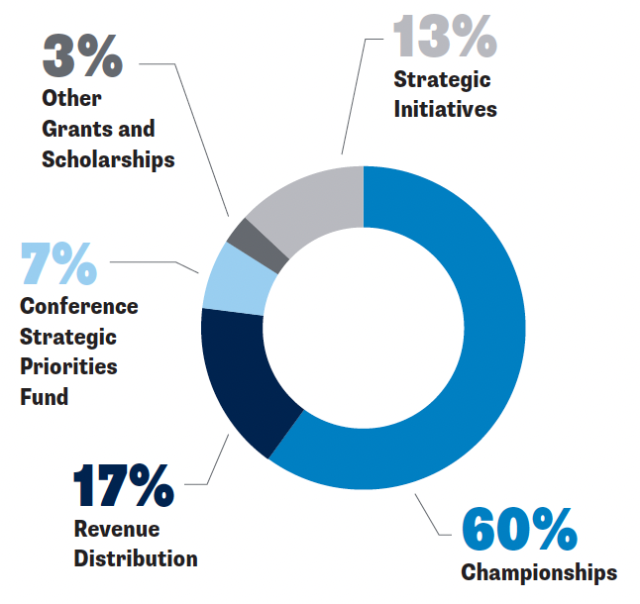
Division II Budget
As legislated in the NCAA Constitution, Division II receives 4.37 percent of the Association’s general operating revenue. The accompanying pie chart is a general picture of how these dollars are allocated (the percentages may vary slightly from year to year).
Notes:
Note to presenters: All of these “buckets” have direct benefits to Division II members, either through program administration, professional development opportunities, and in some cases, direct disbursements (allocation of surplus funds at the end of the fiscal year, for example). DII is intentional in funding a first-class championship experience that includes travel, lodging, meals and per diem. This is a good slide for you to point out how your institution/conference benefits from DII programming (e.g., through your conference grants).

Slide 9
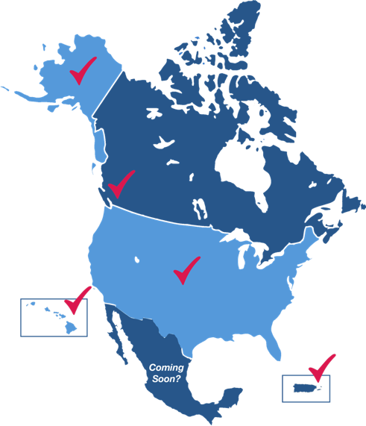
Unique Geographical Footprint
Only division with schools in Hawaii and Alaska
Only division with schools in Puerto Rico
NCAA’s only international member institution (Simon Fraser in Burnaby, British Columbia)
Only division to invite applications from schools in Mexico
Notes:
Note to presenters: The addition of Simon Fraser was the result of a pilot program the NCAA undertook to explore international membership. Division II was the only division to formally adopt legislation to entertain applicants from Canada, and Simon Fraser became an active member in 2012. Then at the 2018 Convention, Division II went even further to adopt legislation that welcomes membership applications from institutions in Mexico.

Slide 10
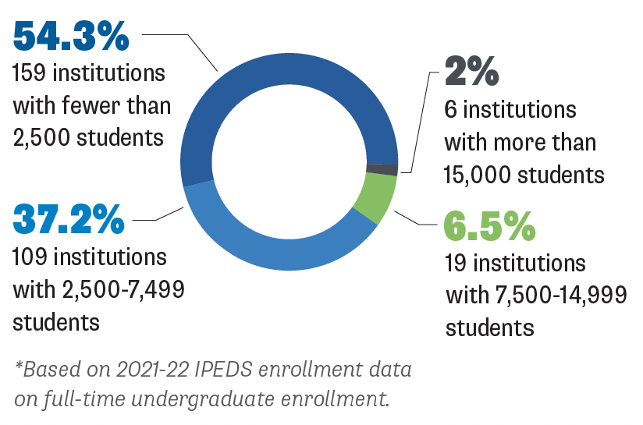
Division II Institutional Characteristics
Enrollment at Division II Active Members*
Notes:
Note to presenters: This diversity of enrollment allows prospective student-athletes a range of opportunities to meet their educational interests and athletics desires. Note however that more than 90 percent of schools enroll fewer than 7,500 students, which provides for a high teacher-to-student ratio.

Slide 11
Division II Institutional Characteristics
Type of School
Percentage of active members
49% private | 51% public
The most balanced ratio among the three divisions
9% Historically Black Colleges and Universities
13% Hispanic Serving Institutions
(both higher than either of the other two divisions)
Notes:
Note to presenters: The public/private ratio in Division I is 67/33 and 20/80 in Division III. Division I has 7 percent HBCUs and 8 percent Hispanic Serving Institutions, while Division III has zero HBCUs and 5 percent HSI.

Slide 12
Division II Institutional Characteristics
Median Cost of Attendance
Division I | Division II | Division III
$47,404 | $39,282 | $54,581
Notes:
Note to presenters: For the purposes of this comparison, the cost of attendance is based on out-of-state tuition. Also note that Division II typically enrolls more first-generation students than either of the other two divisions (20 percent compared with 14 percent in Division I and 15 percent in Division III).

Slide 13
Division II Produces Academic Excellence
Division II Graduation Rates (2013-16 Entering Cohorts)
Category | Student Body Federal Rate | Student-Athlete Federal Rate | ASR
Division II overall | 53% | 60% | 76%
Division II men | 48% | 52% | 69%
Division II women | 57% | 69% | 88%
Notes:
Note to presenters: ASR stands for “Academic Success Rate,” which is a metric Division II adopted in 2006 to more accurately reflect student-athlete academic success, since the federal graduation rate methodology does not account for transfers or freshmen who do not receive athletics aid. Thus, the ASR captures a much larger cohort (about 48 percent more student-athletes) than the federal methodology. However, since there is no comparable ASR methodology for the student body, we have to use the federal rates to compare student-athletes with the general student population. Even in that comparison, the favorable gap between student-athletes and the student body, which over the years has typically been six or seven percentage points, is wider than in Division I and comparable to Division III.

Slide 14
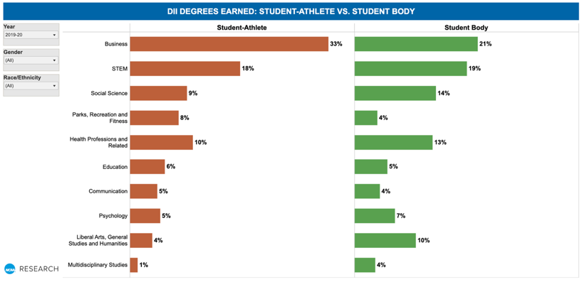
Division II Produces Academic Excellence
Division II student-athletes achieve in their chosen academic pursuits.
  Athletics participation does not limit academic options.
  Degree patterns are similar to those of the student body.
Notes:
Note to presenters: This graphic is from the “Diploma Dashboards,” an NCAA study about undergraduate degrees earned by students and student-athletes at NCAA Divisions I and II institutions. The study is on NCAA.org at http://www.ncaa.org/about/resources/research/division-i-and-ii-diploma-dashboards. A common perception is that student-athletes (especially in DI, but also in DII) pursue “easy majors” to protect their athletics eligibility. The data here counter that argument. This slide (and the diploma dashboards in general) would be interesting to discuss with your FAR before you present it to other groups. Your FAR might also benefit from presenting it to your school’s faculty senate, or similar body.

Slide 15
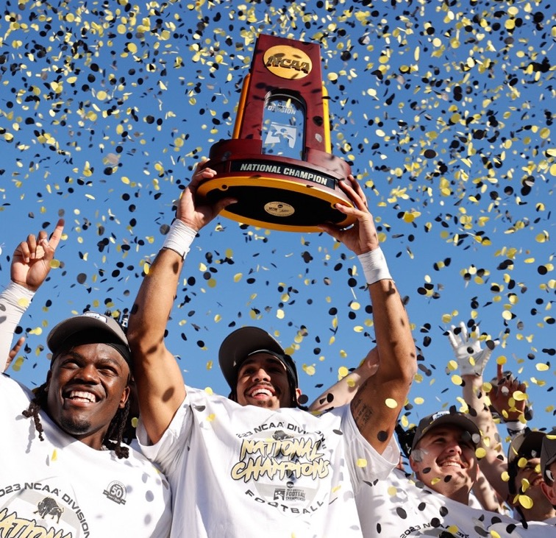
Division II Championships
12 Championships for men’s sports
13 Championships for women’s sports
Championship access ratio is the best among the three divisions
Notes:
Note to presenters: While the access ratio varies slightly from year to year, it is typically between 1:8 and 1:9. The fact that it has to date at least been higher than in ether of the other two divisions is a strong message for prospective student-athletes who would rather compete for a national championship than simply for a conference championship.

Slide 16
Division II Championships
Division II is the only division to offer National Championships Festivals, Olympic-style events in which a number of national championships are held at a single site during a period of several days.
Notes:
Note to presenters: The festivals began in 2004, and there have been 12 to date. Currently, the festivals exist for each sport season, with the idea of conducting one for each of those seasons every four years – ideally so that every student-athlete has a chance to participate in one during the course of their college career. If people ask, the fall festival features men’s and women’s cross country, men’s and women’s soccer, women’s volleyball, and field hockey; the winter festival features men’s and women’s swimming and diving, men’s and women’s indoor track and field, and wrestling; and the spring festival features men’s and women’s tennis, men’s and women’s golf, women’s lacrosse, and softball (though softball will not be a part of the spring sports festival after 2024). Starting in 2026, a men’s and women’s basketball festival will be held every four years. (Some sports, like football, for example, are not included for logistical reasons.) This slide presents a good opportunity for you to note teams from your school that have participated in a festival. Also note that the festivals promote camaraderie among student-athletes from different regions, as they are housed in the same hotels, and they offer ample community engagement opportunities within the host city.

Slide 17
Division II is Affordable
Median Expense for Athletics
  Division II – $6.8 million
  Division I Football Championship Subdivision – $18 million
  Division I Football Bowl Subdivision (autonomy) –
  $104 million
  Division I Football
  Bowl Subdivision
  (non-autonomy) –
  $35 million
Notes:
Note to presenters: The public perception is that college sports is awash in money. On the contrary, only a couple dozen schools’ athletics programs generate revenues over expenses, and they are all in the Division I Football Bowl Subdivision. No other schools generate a profit in athletics. However, as the data suggest, offering a high-level athletics program in Division II requires much less of an institutional subsidy than in Division I – more bang for the buck.

Slide 18
Division II is Balanced
Division II’s “Life in the Balance” approach integrates athletics into the college experience so student-athletes can:
Focus fully on their academic pursuits
Participate in other campus and community activities
Enjoy a well-rounded experience
Become marketable
in their career
Notes:
Note to presenters: Results from the 2018 Division II Membership Census confirm that members value the message of balance, especially in recruiting. Division II student-athletes are afforded the opportunities to achieve whatever lofty goals they aspire to in athletics, yet their athletics participation does not have to be a year-round endeavor.

Slide 19
Division II Cares About Student-Athlete Health and Safety
Division II collaborates with the NCAA Sport Science Institute to provide programs and resources in:
  Nutrition
  Concussion management
  Mental health awareness
  Sexual violence prevention
  Cardiac health
  Substance abuse
  prevention
Notes:
Note to presenters: The NCAA established the Sport Science Institute as a conduit to provide college athletes with the best environment for safety; excellence and wellness through research, education and best practices; and collaboration with member schools, national governing bodies, key medical and youth sport organizations, and the public and private sectors. Also note that the Division II Student-Athlete Advisory Committee, as well as SAACs from your institution and conference, provide lots of input when it comes to these topics.

Slide 20
Division II –
Make It Yours
Division II student-athletes are encouraged to shape their college experience:
  In the classroom
  On the field
  In their career
  For their causes
  On their terms
Notes:
Note to presenters: The Make It Yours campaign aligns nicely with Life in the Balance. When asked what the “It” represents in “Make It Yours,” student-athletes often cite the balanced experience they are afforded as a Division II student-athlete.

Slide 21
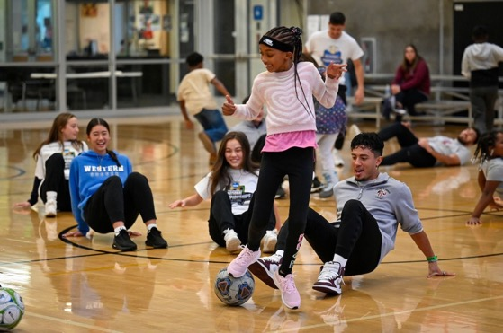
Division II Engages Communities
In Division II, community engagement is about building relationships.
Through student-athlete leadership, Division II has enjoyed long-term and successful partnerships with:
  The Make-A-Wish Foundation
  Team IMPACT
  Veterans and military groups
Division II also conducts community engagement activities at all championships final sites.
Notes:
Note to presenters: In Division II, community engagement means much more than community service. Engagement is more than a gesture of good will – it is interaction that attracts community members to become more involved in your athletics program. Be sure to explain how you accomplish that goal at your institution!

Slide 22
Now that you know about Division II, here are the attributes and characteristics that distinguish
[your institution name here]
Notes:
Note to presenters: Now it’s your turn. Complete this PowerPoint presentation by adding slides that pertain to your institution/conference athletics programs to show how you fit as a member of Division II and what makes you a unique and positive college choice among your competitors. Make It Yours!

