Slide 1

WELCOME to
Notes:
FAC 1
0:00 - 0:01
1 min
DO:
Welcome everyone
Do some housekeeping
Point out exits and other safety announcements

Slide 2

kick off!
FACILITATOR
NAMES
Notes:
FAC 1
0:01 - 0:03
2 min
DO:
Each host/facilitator will introduce themselves
SAY:
Today we are kicking off OUR Game Day experience service framework
To get us started lets get to know what your experience has been.

Slide 3
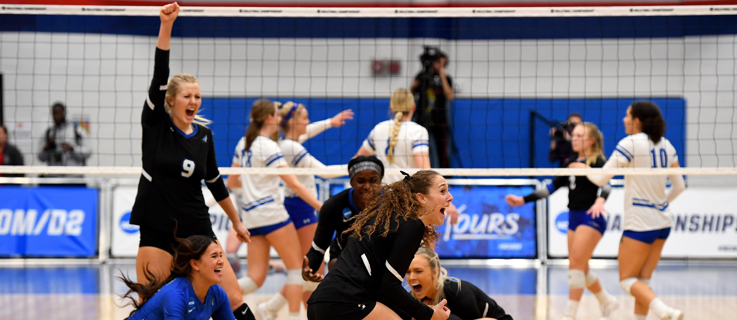
LET’S TALK: EXCELLENT
SERVICE EXPERIENCE
Notes:
FAC 1
0:03 - 0:09
6 min
DO:
Share a brief story of a personal excellent service experience. Amazon, Target, etc.
Encourage team members to share an excellent service experience.
SAY:
Who would like to share an excellent service experience that you have had?
This is a great time to rave about your favorite business.
Feel free to raise your hand to share or add your answer in the chat.
(Acknowledge responses)
SAY:
(After a story…) How did that experience make you feel?
Based on what you heard, what made the experience special?
Did your excellent experiences have anything in common?
OPTIONAL DO:
Have team members raise their hands and share virtually or add their answers to the chat.
SAY:
Just like in your stories, a common theme was that it took people to make those moments memorable.
That’s why YOU are here.
You make a difference to Make Game Day Yours!
But, how can you do that and create a positive experience for each and every fan and each other, while still doing your role?
Is it possible? Yes or NO? (Look for responses in the room)
OPTIONAL DO:
Instruct team members to answer in chat.
SAY:
If we believe we can do it, let’s spend some time thinking about how we can make game day excellent!
Let’s talk about what we bring and what we have in common.

Slide 4
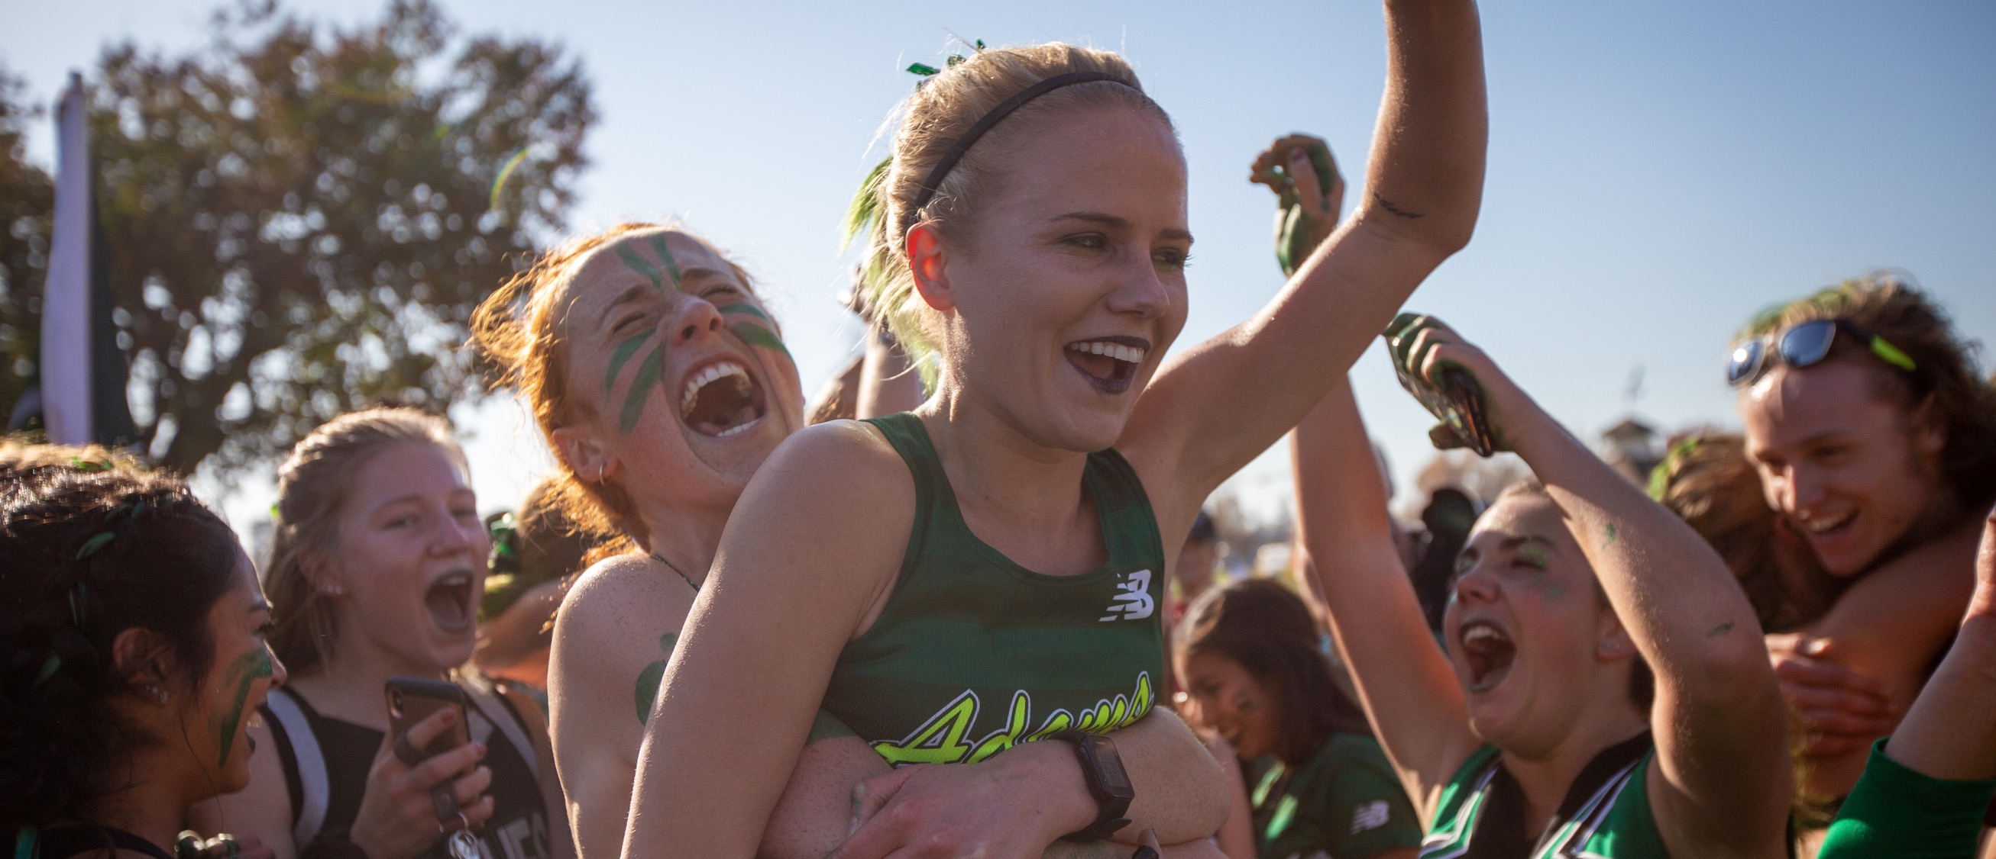
Activity: Common ground
Notes:
FAC 1
0:09 - 0:17
8 min
SAY:
For this activity we are going to have you get in teams to find as many things as you all have in common.
Pick someone to be your “groundskeeper” who will have the role of writing your list.
Are you all ready? OK, you have “3” minutes.
Ready, set, GO!
DO:
Give team members 3 minutes in their teams to create their lists.
When time is up, have team members add up their list of common items and have everyone stand up.
Determine the team with the most items in common by calling out a series of number (e.g., 5, 10, 15) until all teams have sat down and you have a “winning” team still standing.
Have the team read the list aloud.
SAY:
Thanks for playing along and getting to learn a little more about each other. Now, why did we do this activity?
ACKNOWLEDGE RESPONSES
Exactly. - create connections with those we work with—to create the best game day experience.
As part of [school name] you get to bring the best game day experience to life and create winning moments, one fan at a time by making game day yours!
You are a vital part of the game day experience.
However, we also know that there are many challenges and barriers to making this a reality each and every day.
One big challenge is having no idea what the rules are and how create a positive experience moment?
Imagine if you had to guess every day when you came into work about what is expected of you in order to deliver excellent experiences and you had no direction.
Today we want to be intentional and share with you what the Division II game day experience should look like and what it means to MAKE GAME DAY YOURS.
>>FAC 1 - hands off to FAC 2… So Ryan what are the BOUNDARIES/RULES to MAKING GAME DAY YOURS and create that D2 Positive Experience?

Slide 5

defining the game day experience
Rules
Standards
Service Playing Field
Behaviors
Purpose
Notes:
FAC 2
0:17 - 0:21
4 min
Entire field
SAY:
Thats right [FAC 1]. Today we want to share with you what the Division II game day experience looks like and what it means to MAKE GAME DAY YOURS!
We want to introduce you to the foundation of the Division II service culture and bring it to life through the Division II game day Experience Service Playing Field.
Our Service Framework provides us with a common language and a consistent way of creating positive experiences.
To get started, let’s think of it like a four-sided playing field.
Just like in many sports, there is a playing field that is clearly defined by four sides and where the action happens, in bounds.
On one side, we have the teams, scorer’s table, coaches, etc.
This is a pretty clear area, is off limits, and in our service model it represents the Rules.
Rules include: important topics like regulations, campus policies, legal agreements, local laws, etc.
We don’t have much control over this side of the field, but it is critical that every game administrator understands what is included as part of the Rules.
It is important that all of our staff knows our facility requirements, limitations, and Rules.
SAY:
• On the other side of the field, what do you find? Who is cheering for you?
• This is why we exist; our Common Purpose.
• If we know our purpose in our roles on each game day, then it just becomes part of who we are. It is what energizes us to be the best at what we do.
With a clearly defined Common Purpose for all, we can then stay focused on what matters most, no matter what we face.
SAY:
• Next to our Common Purpose, we have Service Standards.
• These are WHAT we do in order to make a decision in the moment and be more consistent in our delivery of service.
• We will be defining these shortly.
• We can only deliver on these Service Standards consistently if we know HOW to do them.
SAY:
Our Service Standards are represented by our Behavioral Guidelines.
• Behavioral Guidelines are observable, measurable, coachable, and repeatable.
• As you can see, our playing field example clearly outlines the Rules, which are non-negotiable.
• Our Common Purpose is what energizes and drives us to be our best.
• Our Service Standards help us all maintain focus and be consistent.
• Our Behavioral Guidelines give us simple and specific ways of behaving—these are the impressions we make on others, based on what we do and say.
• When you are clear about what is in bounds and out of bounds, do you think you can be more successful in your role? (GIVE ME A THUMBS UP - OR NOD)
• SURE! Our playing field helps provide a framework in which all game-day employees are expected to work. It’s the glue that holds us together.
• It also helps unify us all so that we are empowered to be adaptive and responsive to ensure an outstanding game-day experience.
• This not only applies to our people but also to our venues, physical spaces, and our game-day processes.
This will become clear to you as we continue with our training today and look at each component of this field in more detail.
Hand off to [FAC 2]

Slide 6
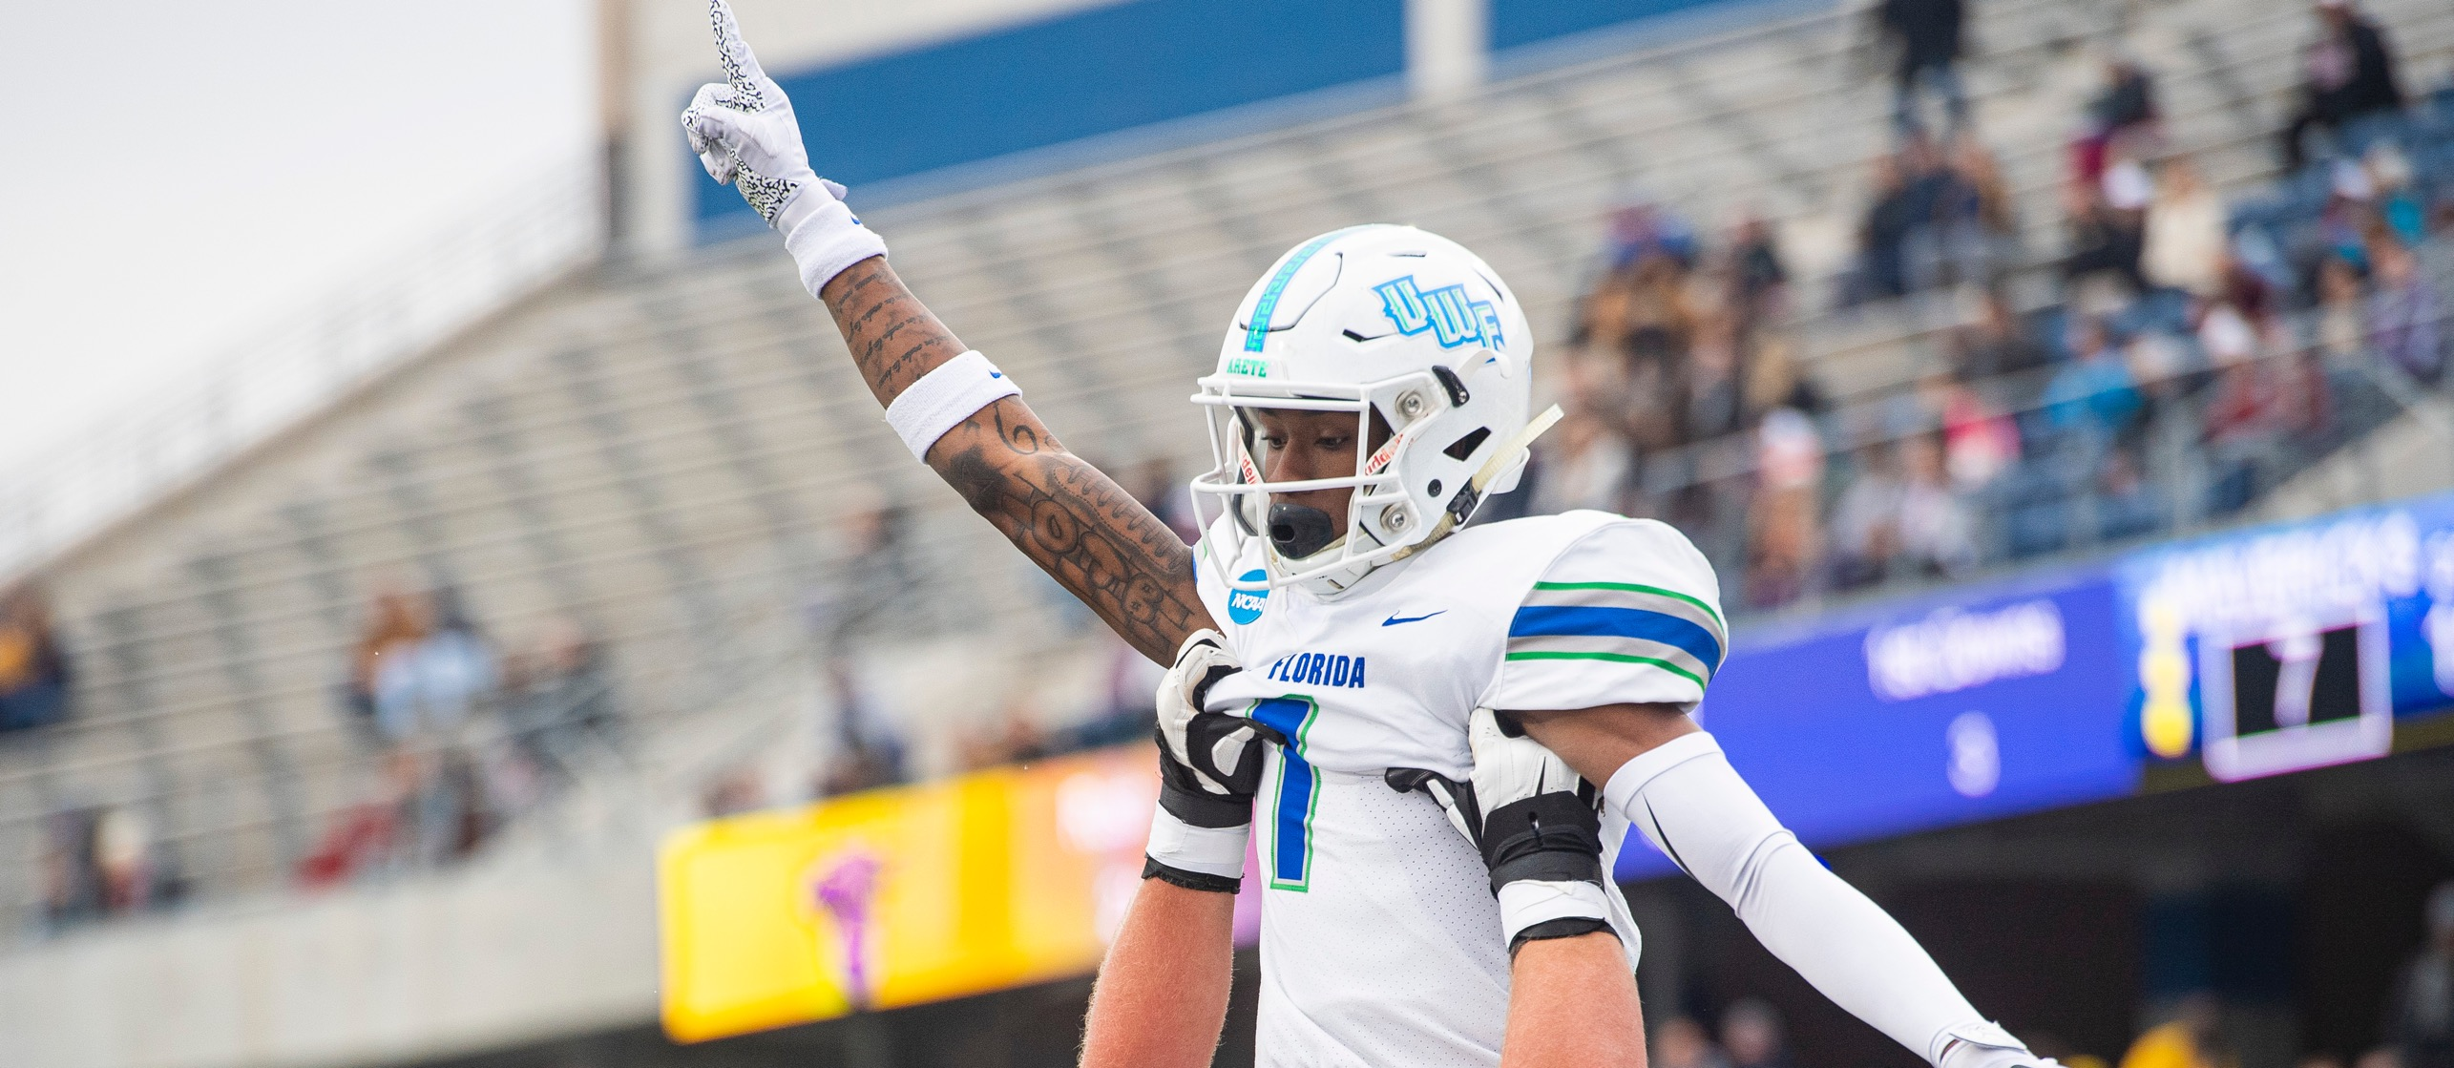
Activity: Point north
Notes:
FAC 1
0:21 - 0:24
3 min
DO:
• Ask everyone to stand (if you are able) and close their eyes with their left one hand.
With the right hand, ask everyone to point in the direction that they feel is “north”.
Ask them to FREEZE and uncover their eyes.
SAY:
• Is everyone pointing in the same direction? (Most likely, not.)
• What does this illustrate? (Look for: A misaligned team, lack of vision.)
• As your facilitator, I failed to define what “north” is. I did not provide clear direction, and I did not give you any tools to try and find out. I did not paint a picture of where we are going.
• Without a COMMON GOAL, we each go in our own direction and what happens then? (Look for: It is confusing and we are all going in different directions; we do not have a common goal.)
• A Common Purpose unites everyone toward the same goal as one team across all roles.
A Common Purpose rallies us toward our “true north” when it comes to providing outstanding service. It is not meant to be memorized. It is meant to be internalized, so that you inherently know it and FEEL it.
Have a seat, thank you!

Slide 7
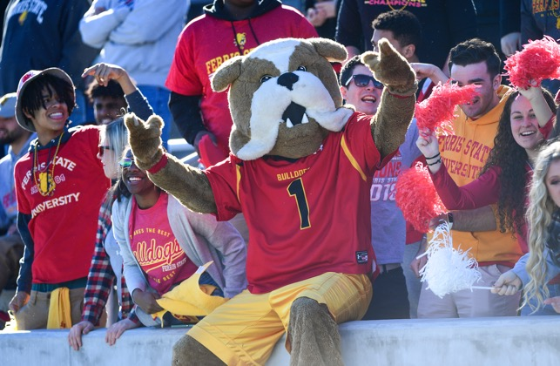
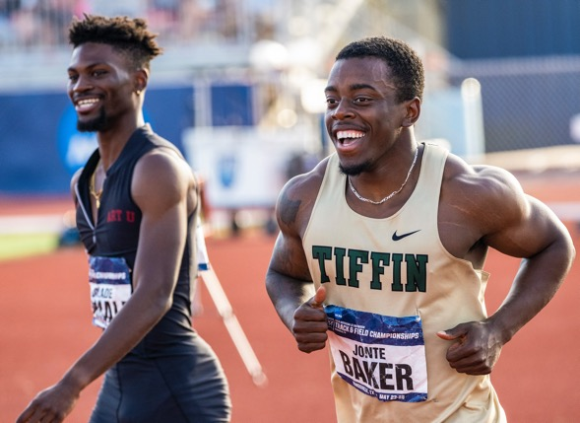
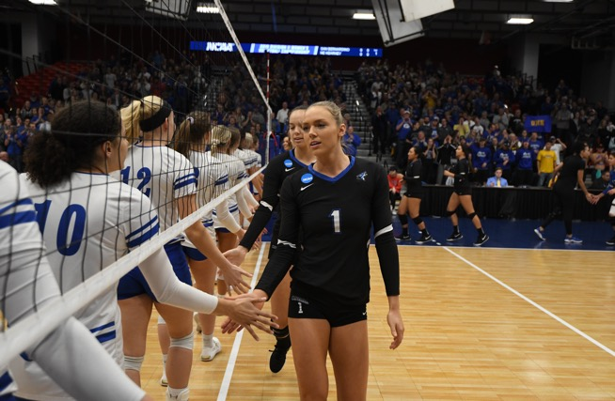
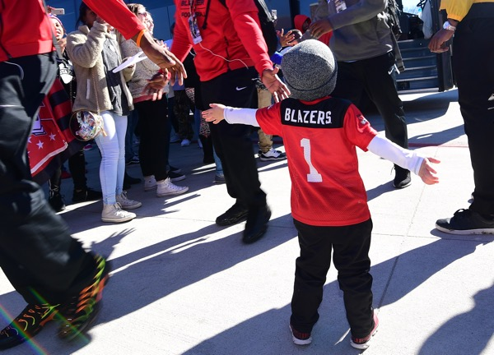
our common purpose
We create a respectful and engaging educational environment through athletics, for everyone.
Notes:
FAC 1
0:24 - 0:26
2 min
SAY:
• So, what is our common goal? What is our true north?
• I think you would all agree, our purpose is to create a unique experience that is positive and upholds what we value in academics and athletics.
To do that, we must all be going in the same direction - a Common Purpose
DO:
REVEAL & READ: We create a respectful and engaging educational environment through athletics, for everyone.
SAY:
NOW Let’s read it together. Ready, 1, 2, 3!
This is not the same as a mission or vision statement.
This is our Common Purpose and it drives us to deliver something special at each and every event that we host.
WHAT do you think is the most important word?
(ACKNOWLEDGE all responses - then point them to the word - WE!)
Without WE none of this happens! Not some, not a few, ALL of US!

Slide 8
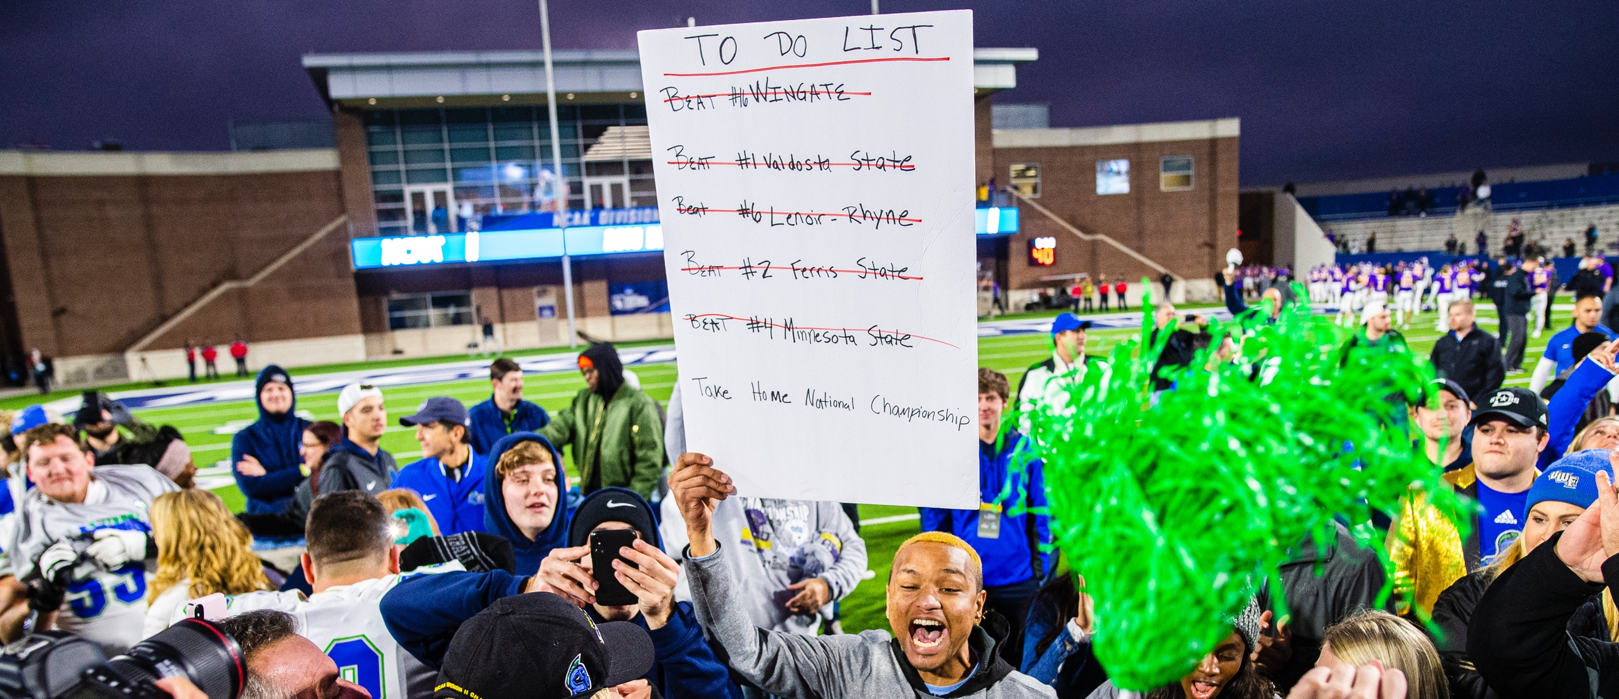
purpose vs. task
Notes:
FAC 1
0:26 - 0:29
3 min
SAY:
Let’s think about it this way.
What are some of your tasks at our events? (Look for: taking tickets, selling concessions, etc.)
Do we have any one in tickets, selling concessions, parking or ALL THREE , haha)
• Tasks are important and must get done, but the most important thing is that we STAY on PURPOSE.
• Whether you play or watch sports, you know everyone has a role and task to perform on a team.
With a clear purpose, teams can go further faster and achieve things that are beyond what any one task or individual can do.
When we keep our purpose TOP OF MIND: We create a respectful and engaging educational environment through athletics, for everyone.
When we say purpose vs. task, we mean to go beyond your task and focus on our purpose.
Sometimes it may be necessary to PAUSE the task we are doing in order to deliver on our Common Purpose. Then, resume the task. We can do our ROLE but now it has a SOUL.
Being on purpose means serving, interacting, assisting, and making connections with our fans and each other.
Let me share a story : insert Fernando’s new story.
SAY:
FAC 2 I think they are ready to Make It Their OWN… (that is the cue to start handing out EASLE paper to each table)

Slide 9
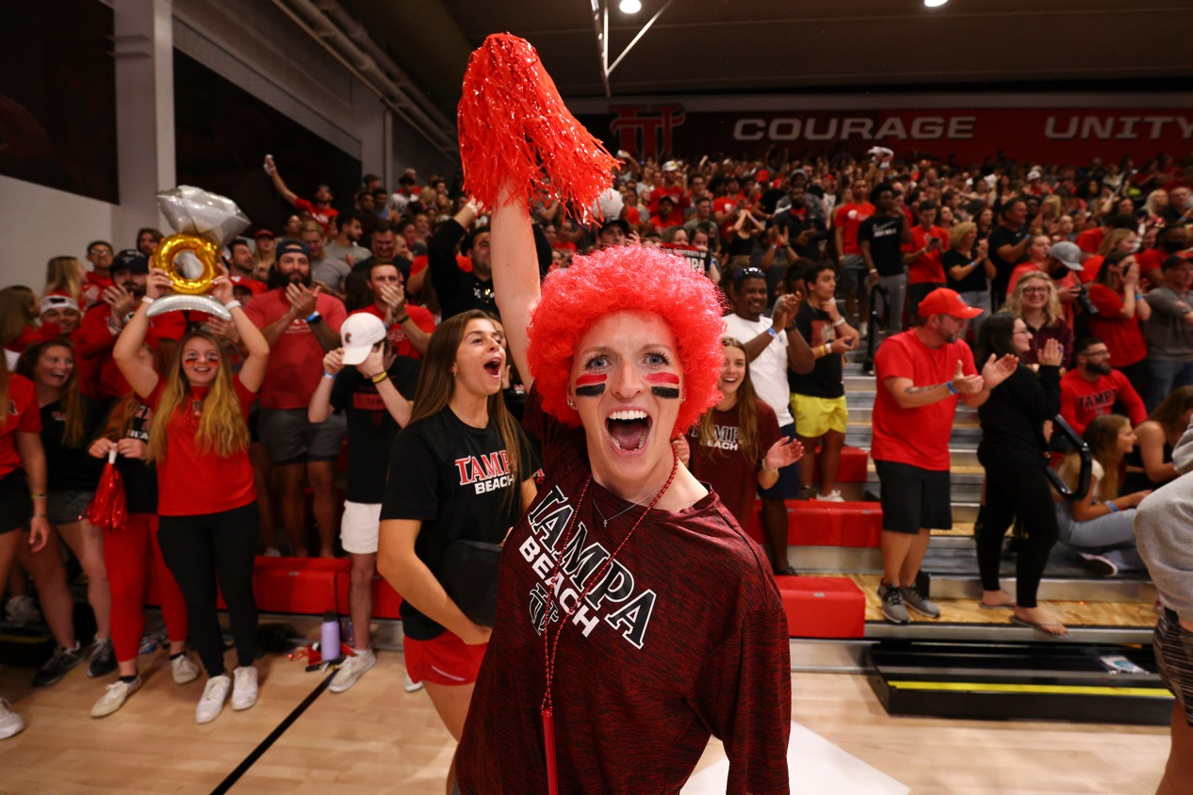
Activity: picture our purpose
What does our Common Purpose look like to you?
Notes:
FAC 1
0:29 - 0:30
>1 min
SAY:
So what do you ALL think OUR common purpose would look like if it came to LIFE on Game Day?
Thats what we want you all to do next as FAC 2 hands out the paper you all will use…

Slide 10
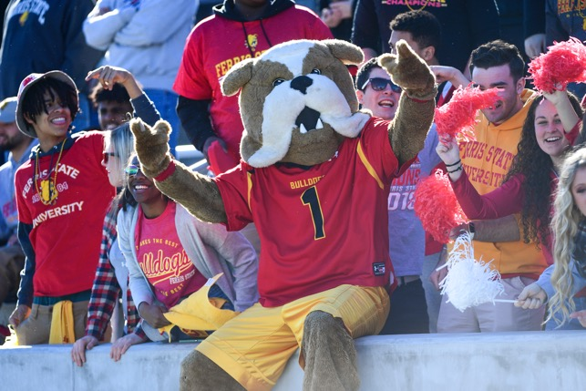
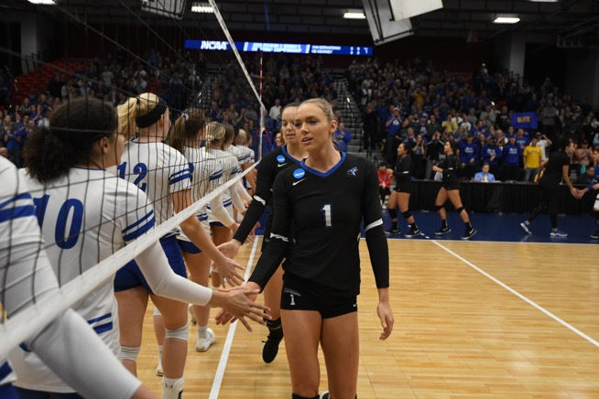
our common purpose
We create a respectful and engaging educational environment through athletics, for everyone.
Notes:
FAC 1
0:30 - 0:37
7 min
DO:
Each table will be a team.
Have them assign an illustrator to draw the image of what the Common Purpose looks like in ACTION.
Give each team “5” minutes to draw their illustrations.
Once they are done, have the team tape it to a nearby wall.
FAC 1 and 2 pass out tape

Slide 11
Activity: picture our purpose
What are some common themes you observed?
What did you learn from each other?
What would happen if these illustrations actually happen every day?
Notes:
FAC 1
0:37 - 0:42
5 min
DO:
Have them WALK AROUND/LOOK AROUND and have them look for…
“What are some common themes you observed?”
“What can you learn from each other?”
“What would happen if these illustrations actually happened every day?”
AFTER a few minutes of discussion…
ASK:
Now that we have a clear Common Purpose, let’s take a look at how we can deliver it in a consistent way.
>>FAC 1 hands off to FAC 2: So [FAC 2] take us to the next boundary of our service playing field…

Slide 12

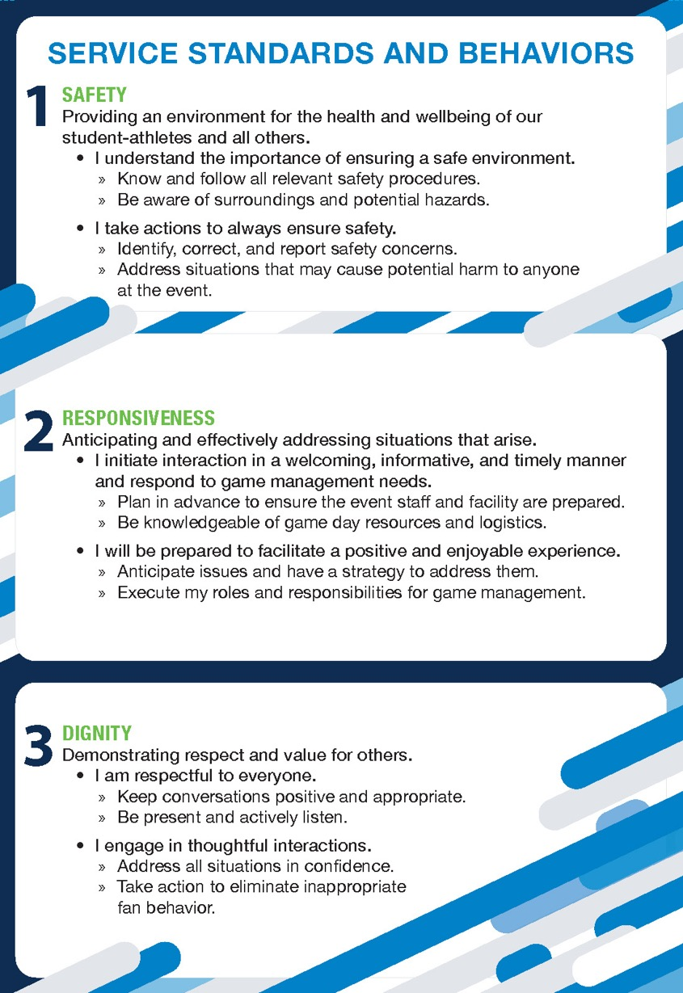
Notes:
FAC 2
0:42 - 0:42
<1 min
DO:
• Reference the digital Service Card.
• Point out the Common Purpose.

Slide 13
defining the game day experience
Rules
Standards
Service Playing Field
Behaviors
Purpose
Notes:
FAC 2
0:42 - 0:43
1 min
SAY:
• On your Service Cards, not only do we have our Common Purpose, we also want you to know WHAT and HOW we will deliver this on game day.
This takes us to the next boundary…our Service Standards.
So what are Service Standards? As you recall, in our playing field, it made up one of the clearly marked sides of the playing area.
• Therefore, we want to make sure we ALL understand what they are and how to bring them to life.
• For starters, Service Standards are operating priorities that drive the consistent delivery of service.
• The Make Game Day Yours Service Standards are for the entire organization but we are able to adapt them to our culture in the local area at your school.

Slide 14

our service standards
Dignity
Experience
Responsiveness
Safety
Notes:
FAC 2
0:43 - 0:45
2 MIN
DO:
Reveal the four words in alphabetical order. (words build)
SAY:
• Our Service Standards speak to what is most important to our fans and student-athletes AND provide an easy way to stay focused on service, because our fans NEED us to: (click to reveal each word one by one)
» Be respectful to everyone and our environment, which is DIGNITY.
» Create a positive atmosphere, or EXPERIENCE.
» Anticipate and effectively address situations that arise, to show RESPONSIVENESS.
» Always practice safe behavior in everything we do. SAFETY ALWAYS comes first.

Slide 15

Notes:
FAC 2
0:45 - 0:46
1 MIN
They need to be prioritized - explain
FAC 2 Hands off to [FAC 1]

Slide 16
our service standards
Safety
Responsiveness
Dignity
Experience
Notes:
FAC 2
0:46 - 0:49
3 MIN
DO:
• Reveal the four words in order. (words build)
SAY:
• Service Standards are prioritized in order to help make decisions so that when we are in the middle of a service moment, we immediately know what is most important.
• ALL of the standards are important ALL of the time, but when we have to make a decision or if there is a situation when two standards conflict—we must have a defined order so that we know what to do, no matter our role, title, or responsibility.
• This intentional approach allows us all to be empowered to be effective and consistent, and own the moment.
• Therefore, our Service Standards in priority order are:
1. Safety
2. Responsiveness
3. Dignity
4. Experience
• So let me give you a little more context and definition around each one…

Slide 17
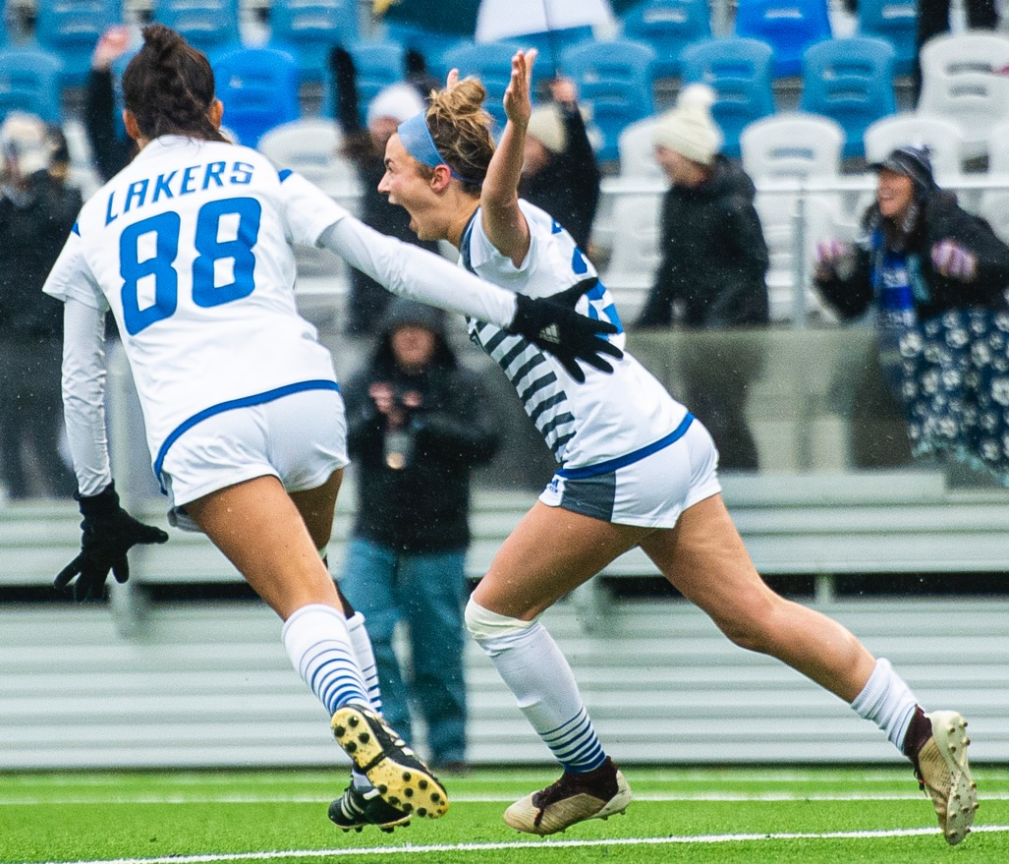
safety
Providing an environment for
the health and wellbeing of our student-athletes and all others.
Notes:
[FAC 2] PAT
0:49 - 0:49
30 SECONDS
DO:
• Reveal the definitions.
SAY:
• Our Service Standards are:
1. Safety - Providing an environment for the health and well-being of our student-athletes and all others.

Slide 18
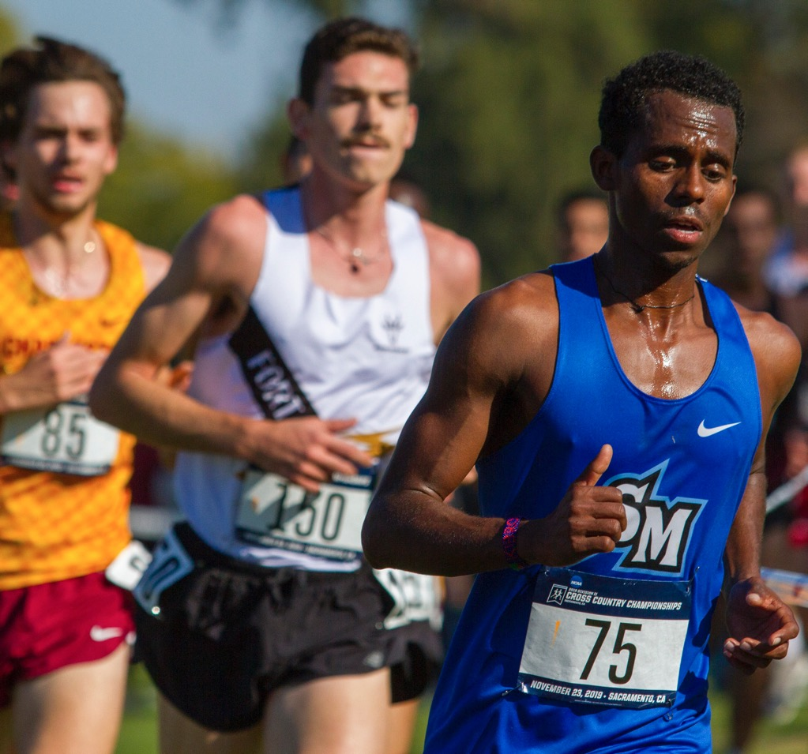
responsiveness
Anticipating and effectively addressing situations that arise.
Notes:
FAC 2 PAT
0:49 - 0:49
30 SECONDS
2. Responsiveness - Anticipating and effectively addressing situations that arise.

Slide 19
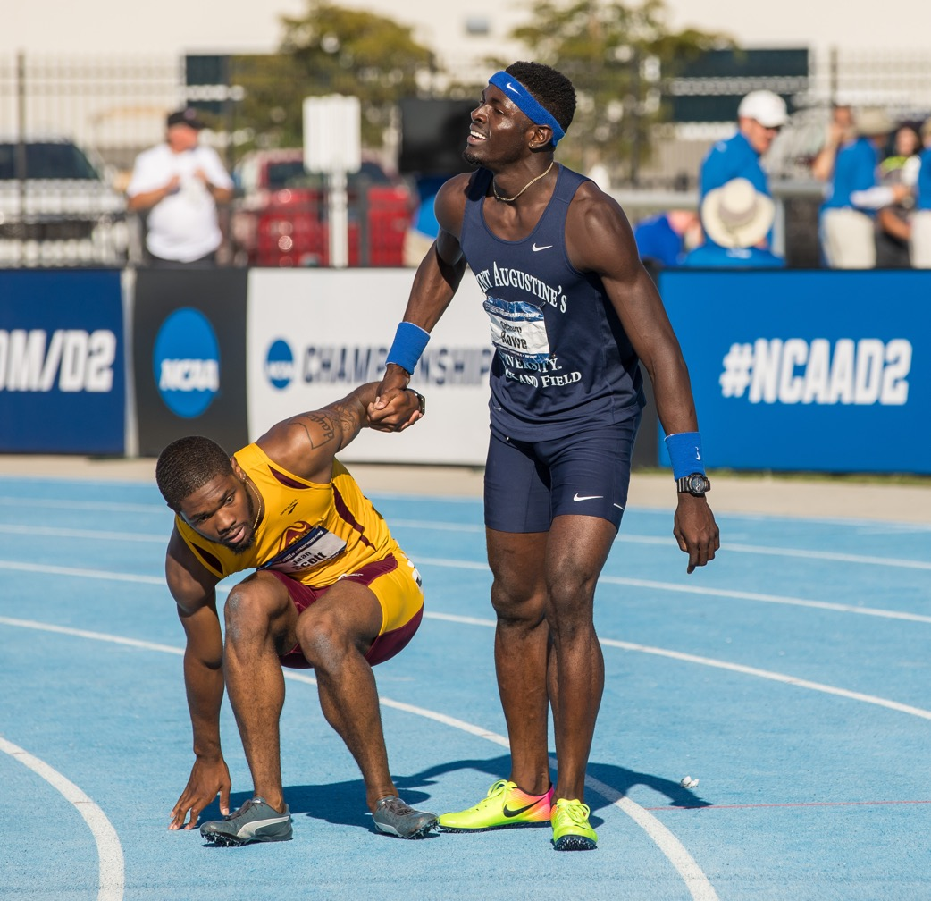
dignity
Demonstrating respect and value for others.
Notes:
FAC 2 PAT
0:49 - 0:50
30 SECONDS
3. Dignity - Demonstrating respect and value for others.

Slide 20
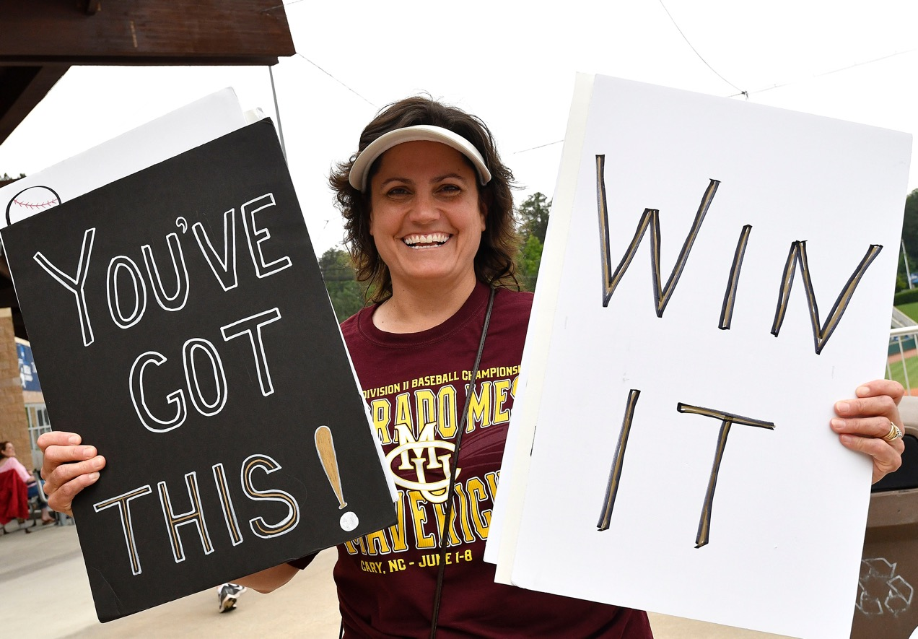
experience
Creating a positive atmosphere.
Notes:
FAC 2 PAT
0:50 - 0:50
30 SECONDS
4. Experience - Creating a positive atmosphere.
SAY:
When fans encounter us making consistent positive decisions in the service moment, they have increased confidence in the game day experience, confidence in the response of game management, and a self-awareness of their own boundaries for behavior during our events. Their confidence is based on our consistent responses.
It also means you ARE CONFIDENT—you are making the BEST decision in the moment.
Hand off to RYAN and say:
Ryan, I think you have a story to illustrate the importance of prioritizing the standards to make the best decision…

Slide 21
our service STORY
Safety
Responsiveness
Dignity
Experience
Notes:
FAC 2
0:50 - 0:53
3 MIN
Share a story
Here is an example of what we mean.
Let’s say one of your tasks is to keep the counter has gotten messy—this is not a good Experience because the atmosphere is not ideal. However, many people have started lining up for service and to keep them waiting is not Responsive.
So you sacrifice Experience by leaving the messy condiment area in order to show Responsiveness and create a positive and enjoyable experience for fans.
You might even say, “Please excuse our mess, but I don’t want you to have to wait for me.” By making this decision, you are also displaying Dignity because you are showing that you value the fans and respect their time.
Thinking of our standards and their definitions in prioritized order helps each of us make the best decisions in the service moment and create the best game day experience possible.
FAC 2 hands back to FAC 1
Now that we have introduced the standards, FAC 1 can you take us to our next boundary?

Slide 22
defining the game day experience
Rules
Standards
Service Playing Field
Behaviors
Purpose
Notes:
FAC 1
0:53 - 0:54
1 MIN
DO:
• Refer back to the Service Cards.
• Teach back to the Common Purpose and Service Standards.
SAY:
• Finally, we want to finish outlining our playing area for exceptional service by discussing the value and importance of knowing and understanding the Behavioral Guidelines.
• They act as performance tips. When used correctly, the expectation is to demonstrate all the Behavioral Guidelines. This will mean you are meeting the expectations of exceptional service delivery.
• Remember, these behaviors are designed to be trainable, observable, and coachable.
What do you think would happen if all we did was introduce the words and did not share the behaviors?
Listen for: We would make it up, there would be a lack of consistency they would become words on a wall.
SAY:
That’s right. So we are going to go through these behaviors together, and I want you to start thinking about how these apply to your current roles.

Slide 23
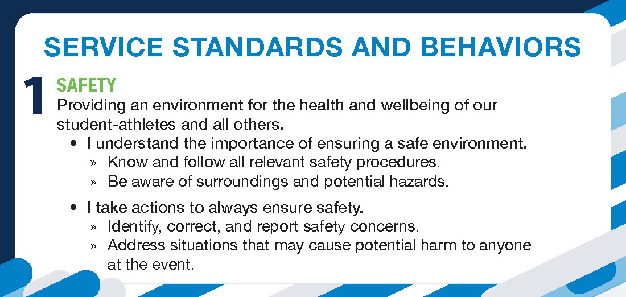
safety
Notes:
FAC 1
0:54 - 1:00
6 min
All 4 panels
SAY:
They are “I” statements because we all need to be accountable: Lets review

Slide 24
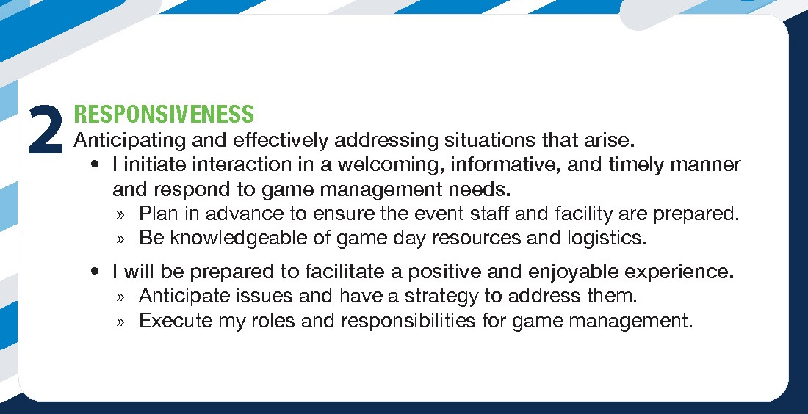
RESPONSIVENESS
Notes:
FAC 1
0:54 - 1:00
6 min
All 4 panels

Slide 25
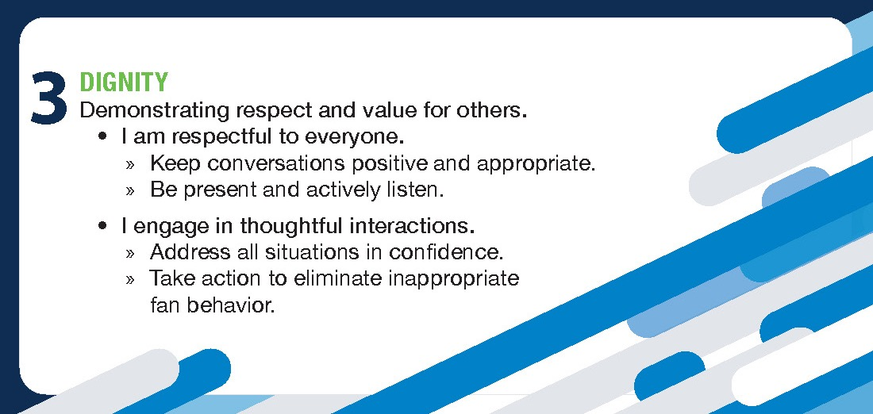
DIGNITY
Notes:
FAC 1
0:54 - 1:00
6 min
All 4 panels

Slide 26
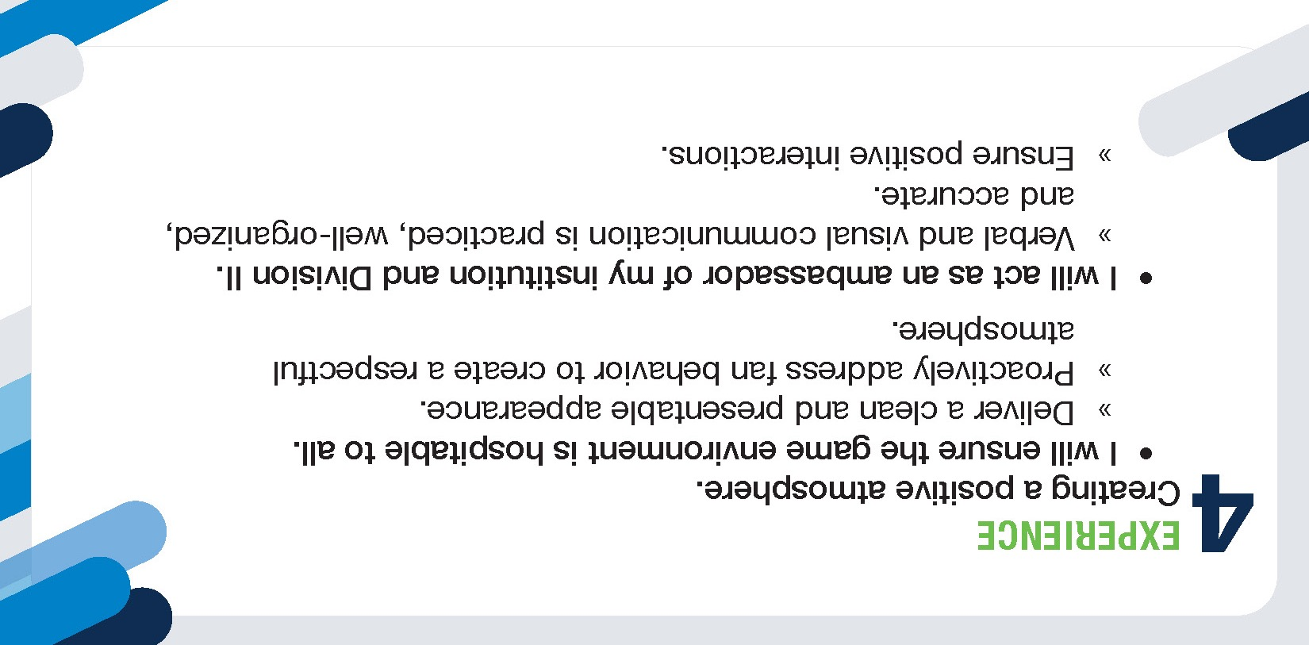
EXPERIENCE
Notes:
FAC 1
0:54 - 1:00
6 min
All 4 panels

Slide 27
Notes:
FAC 1
1:00 - 1:01
<1 MIN
SAY:
So now that we have an awareness of the Make GAME day YOURS Service PLAYING FIELD… I think FAC 2 has a special assignment for us…
FAC 1 hands off to FAC 2

Slide 28
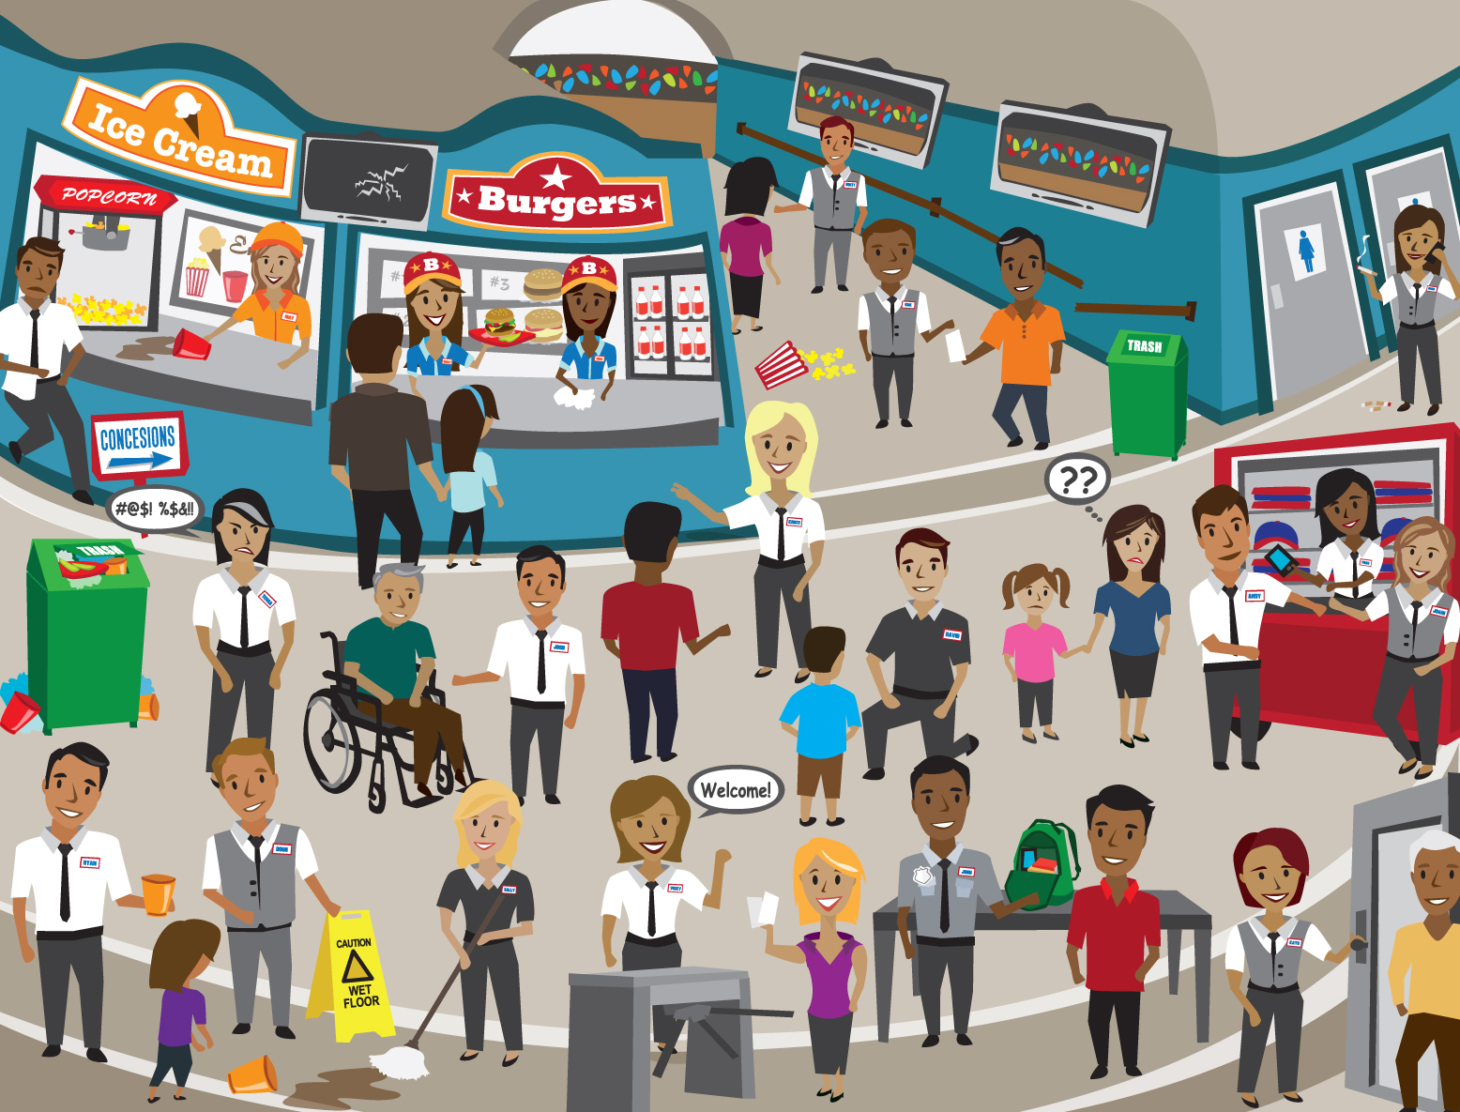
LET’S Talk: In bounds/ out of bounds
Notes:
FAC 2
1:01 - 1:02
1 MIN
Set it up
SAY:
For the purpose of this activity, think specifically about our service playing field
Most of us have been to a sporting event or concert before and we’ve all seen moments that are in bounds and out of bounds examples.
• In-bounds moments would take place within the service playing field, and out-of-bounds moments would be outside of the service playing field.
I am going to ENLARGE this image on the screen for us to review and look for examples of service moments that are in bounds and out of bound.
I am going to divide the room and this side will be my team and we are looking for inbound moments and that side with FAC 1 will look for out of bound moments.
I am going to give you a minute to spot some of them and then we will begin…

Slide 29
LET’S Talk: In bounds/out of bounds
Notes:
FAC 2
1:02 - 1:08
6 MIN
• These scenarios relate to our service standards and behaviors that we went over a few minutes ago.
(after a minute) Let’s start with OUT-OF-BOUNDS moments?
(Acknowledge responses)
Now how about some IN-BOUNDS moments
(Acknowledge responses)
Alternate back and forth a few times and consider ending on a positive note.
SAY:
GREAT JOB - A big APPLAUSE for MAKING GAME DAY YOURS!!!
With our new standards and behaviors, you now have a common language to help guide you and empower and give you confidence to be more intentional and deliberate in creating service moments that are in bounds and identifying out-of-bound moments that should be addressed.
>> FAC 2 hands off to FAC 1 - “FAC 1, I believe you have another TOOL to help MAKE GAME DAY a great experience for ALL…

Slide 30
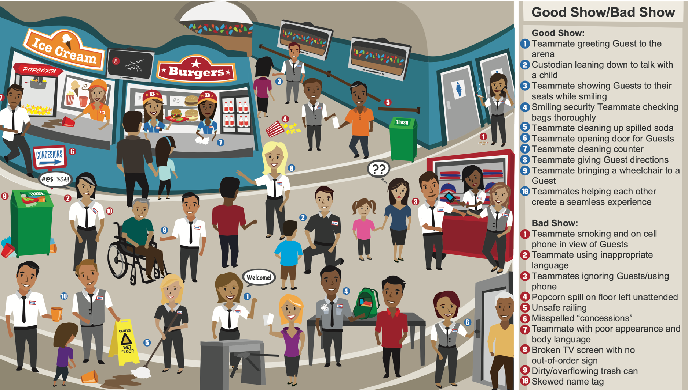
Activity: In bounds/out of bounds

Slide 31
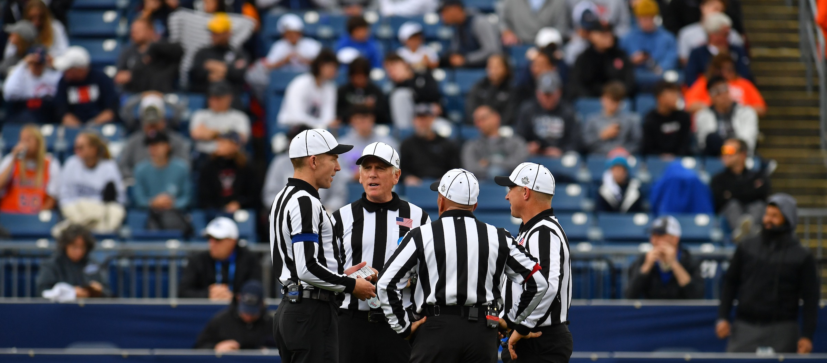

Notes:
FAC 1
1:08 - 1:09
1 MIN
Set up
SAY:
• As you can see, it is possible to be more deliberate in creating memorable moments consistently as a team for each other, our teams, and our fans.
• But when things go out of bounds, we need to consider how we engage in the moment and get back inside the service playing field.
• We want to introduce and provide you with a tool to help in those challenging moments.
The goal of this tool is to help you
LEAD2 a less confrontational moment,
LEAD2 an empathetic approach, and
LEAD2 a memorable experience

Slide 32
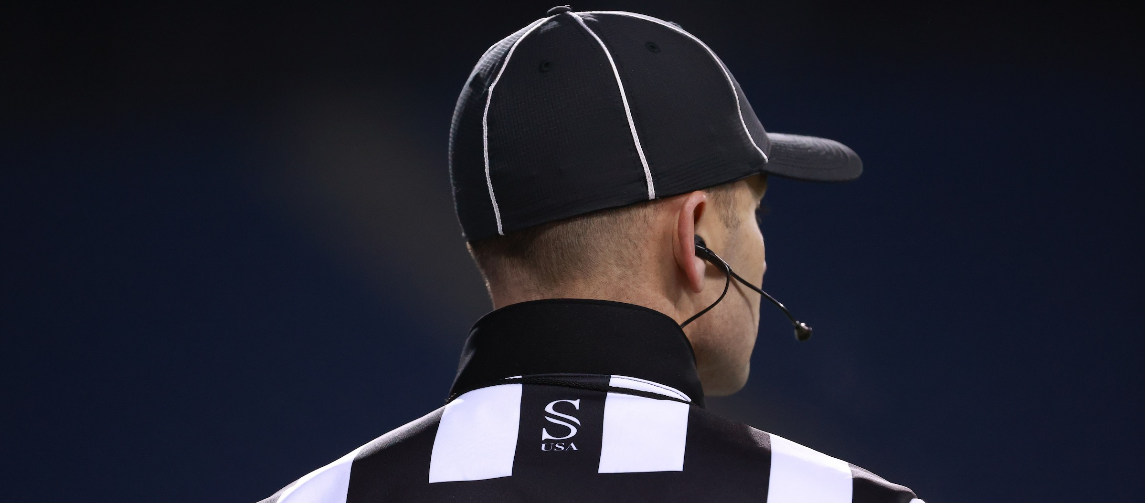
LEAD2
Listen
Empathize
Apologize
Decide
Deliver
Notes:
FAC 1
1:09 - 1:12
3 MIN
DO:
Review the LEAD2 tool.
Emphasize the 2 in LEAD2 after talking Decide and Deliver
SAY:
• Our LEAD2 Service Excellence tool allows us to engage in a more intentional way. Here is how.
• In a situation you want to:
Listen – hear words and context, ask what they want
Empathize – acknowledge their emotions, approach with no ego
Apologize – Many times we think we are now responsible when we apologize - what we are saying is that it is about being responsive and it shows we place a higher value on the other person and its less about WHO is right and wrong.
Decide – on an appropriate resolution and follow through
Deliver – by following up
• Now that we have reviewed, you can see why we call it the LEAD2 tool, because of both DECIDE and DELIVER.
At the end of the day, when we put ourselves in our fans shoes, we are experiencing the event from their point of view.
We also want to deliver on our STANDARDS - Safety - Responsiveness - Diligent and Experience
We NEED to take ownership of their experience.
You may not have to act on every part of this tool, but there are situations where you will need to make decisions to use parts of it.
• Every issue is not our fault, but it is our problem!”

Slide 33
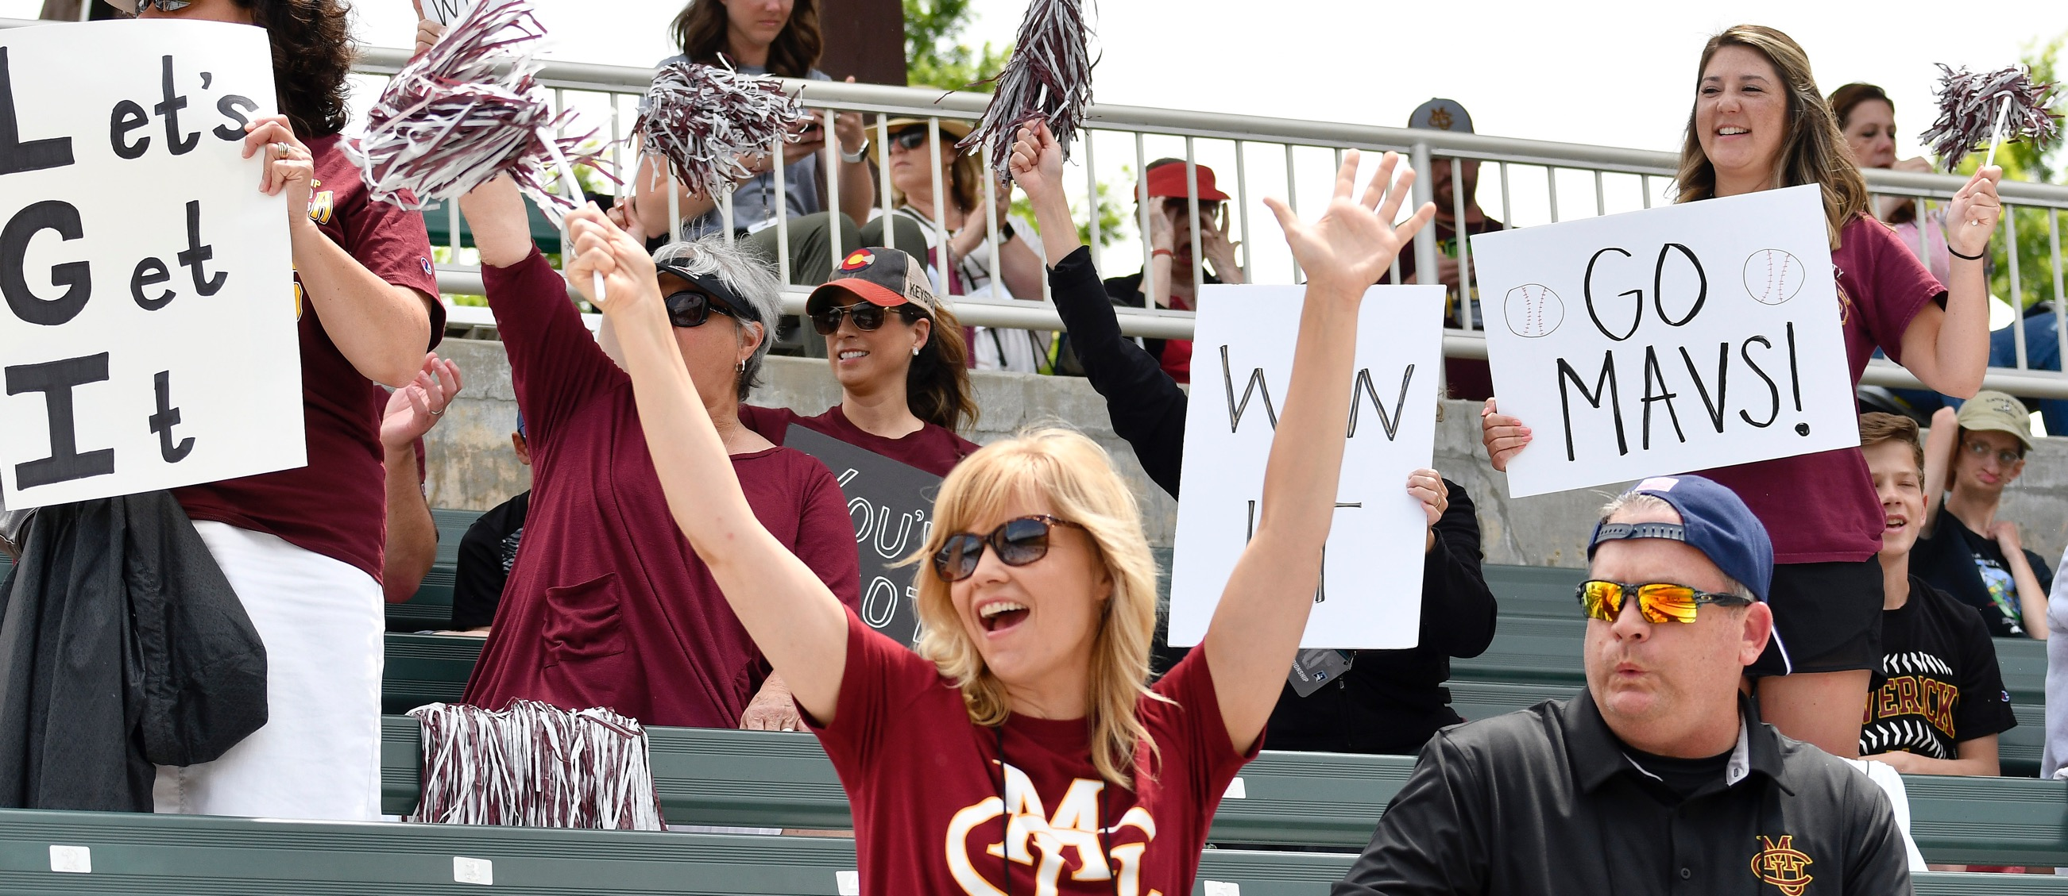
activity: how will you lead2 service excellence?
Notes:
FAC 1
1:12 - 1:13
1 MIN
DO:
• Set up activity….
• Select two/three scenarios.
• Copy each scenario in the chat.
• Give each team a minimum of 5 minutes to identify a solution that uses the LEAD2 approach.
SAY:
• Now that we have reviewed LEAD2, let’s focus on how you would use LEAD2 in these specific scenarios.
• Review your specific scenario and discuss the following questions:
-How would you use the Service Playing Field to engage and LEAD2 Tool to solve?
• Let’s read them out loud first..

Slide 34
Make It Yours
An overly enthusiastic fan spills their drink on the person next to them while sitting in the stands. You notice that the other person is getting very upset and things were starting to heat up. Using the Service Playing Field & LEAD2, what would you do?
#1
Notes:
FAC 1
1:13 - 1:14
1 min to read ALL THREE

Slide 35
Make It Yours
In your capacity as game administrator, you see a student-athlete’s parent move behind the team’s bench and begin cursing and yelling at the coach about a decision that the coach has just made. Using the Service Playing Field and LEAD2, what would you do?
#2
Notes:
FAC 1
1:13 - 1:14
1 min to read ALL THREE

Slide 36
Make It Yours
You are working at a concession stand and a fan claims that she accidentally dropped her ice cream and she’d like a new one. There are no obvious signs of spilled ice cream, and you don’t remember seeing her before. Using the Service Playing Field & LEAD2, what would you do?
#3
Notes:
FAC 1
1:13 - 1:14
1 min to read ALL THREE

Slide 37

activity: how will you lead2 service excellence?
Notes:
FAC 1
1:14 - 1:24
10 min
SAY:
We will give you 5 minutes to discuss. Ready, set, GO!
AFTER 5 min go to each team and have them share… 5 min to debrief
SAY (debrief):
• Would anyone like to share how they would resolve one of the two/three scenarios?
• Did you discover a new way to handle a difficult situation or confrontational moment?
• Did you see how the standards also come into play to help solve a difficult situation?
Have you had a scenario that you can look back on that you did not handle well?
If so, how would you have handled it differently now knowing the LEAD2 tool?
When we LEAD2, we get to Make Game Day Yours!
> [FAC 1] passes to [FAC 2] (RYAN) and SAY: I think there is one more thing we want to do…

Slide 38
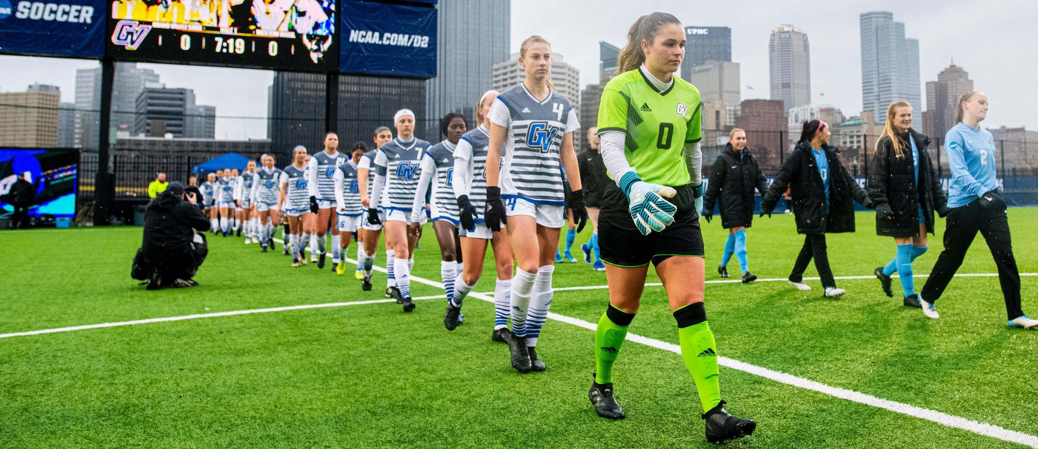
activity: make game day yours!
Notes:
FAC 2 RYAN
1:24 - 1:27
3 MIN
SAY:
• Now, before we leave, I want everyone to please think about one thing YOU plan to do differently next game day in order to create an excellent experience and Make Game Day Yours!
DO:
• Have them write down on their Service Cards where they say: “I will commit to...”

Slide 39

our common purpose
We create a respectful and engaging educational environment through athletics, for everyone.
Notes:
FAC 2
1:27 - 1:30
3 MIN
SAY:
Let me share a story of why this is personal to me…
So then say:
Before we leave lets say our Common Purpose one more time…
[FAC 2] Hand back to FAC 1 to close

Slide 40
THANK
YOU!

Slide 41
APPENDIX

Slide 42
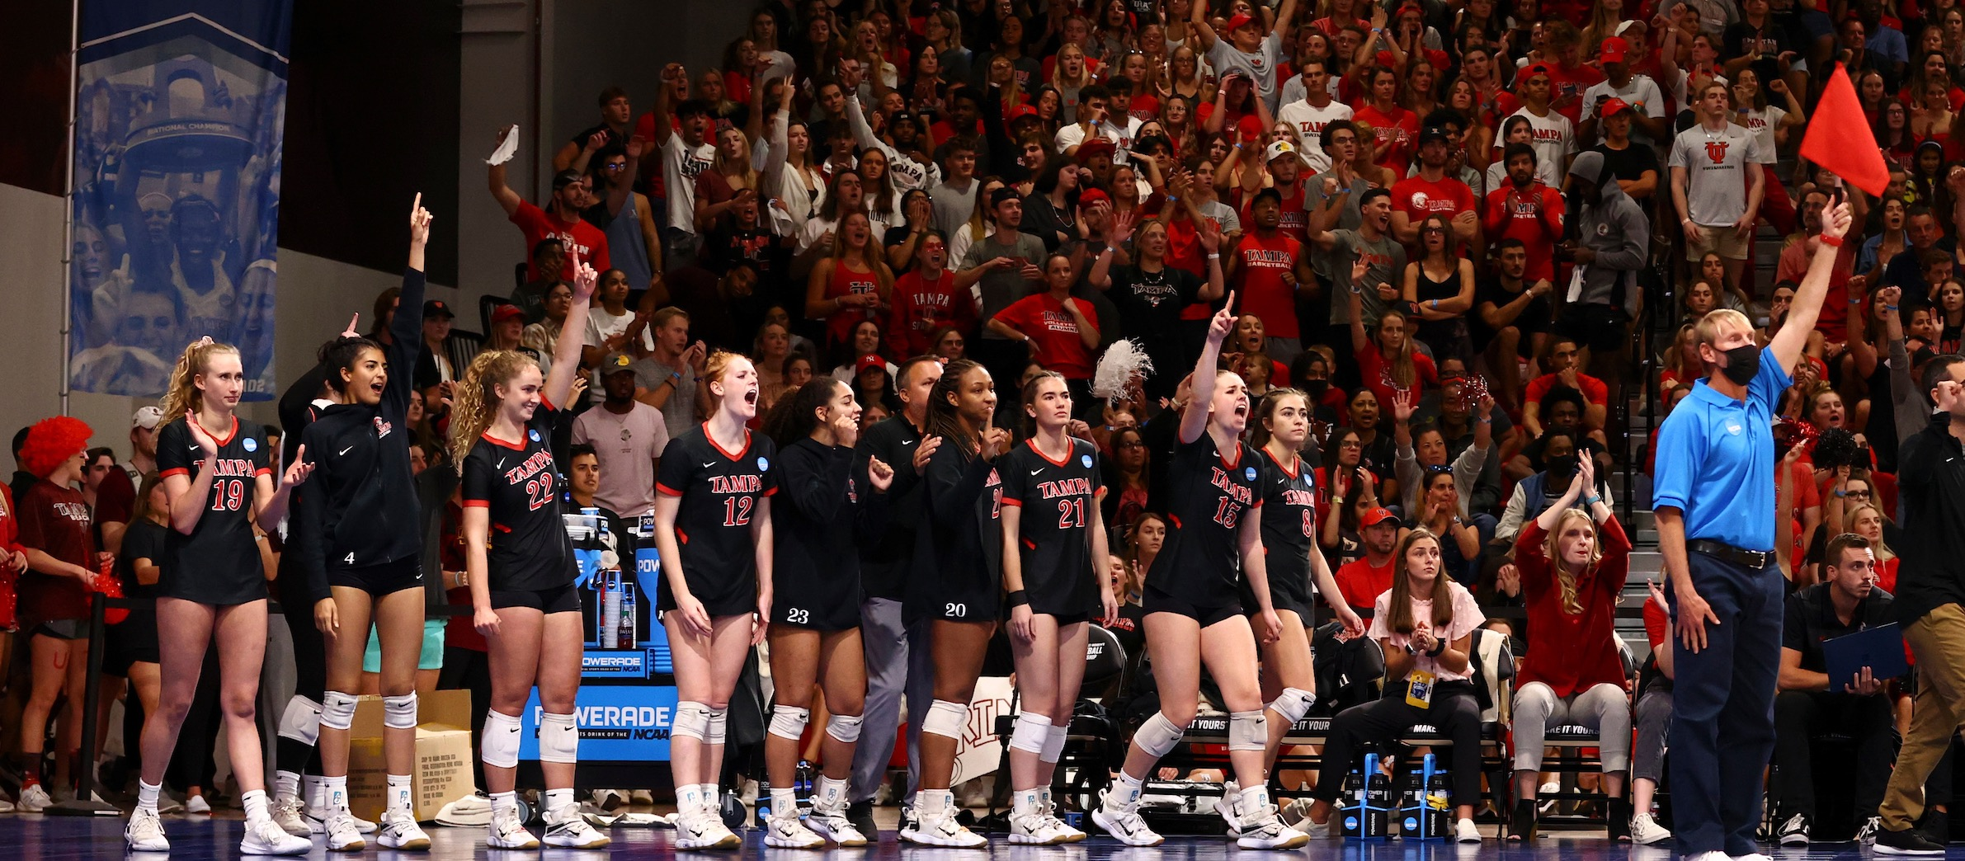
LET’S TALK: What is your super power?
Notes:
0:02 - 0:08
6 MIN
Just Chat/Talk in the main room

Slide 43


PAPER TWIST
Notes:
7 MIN

Slide 44
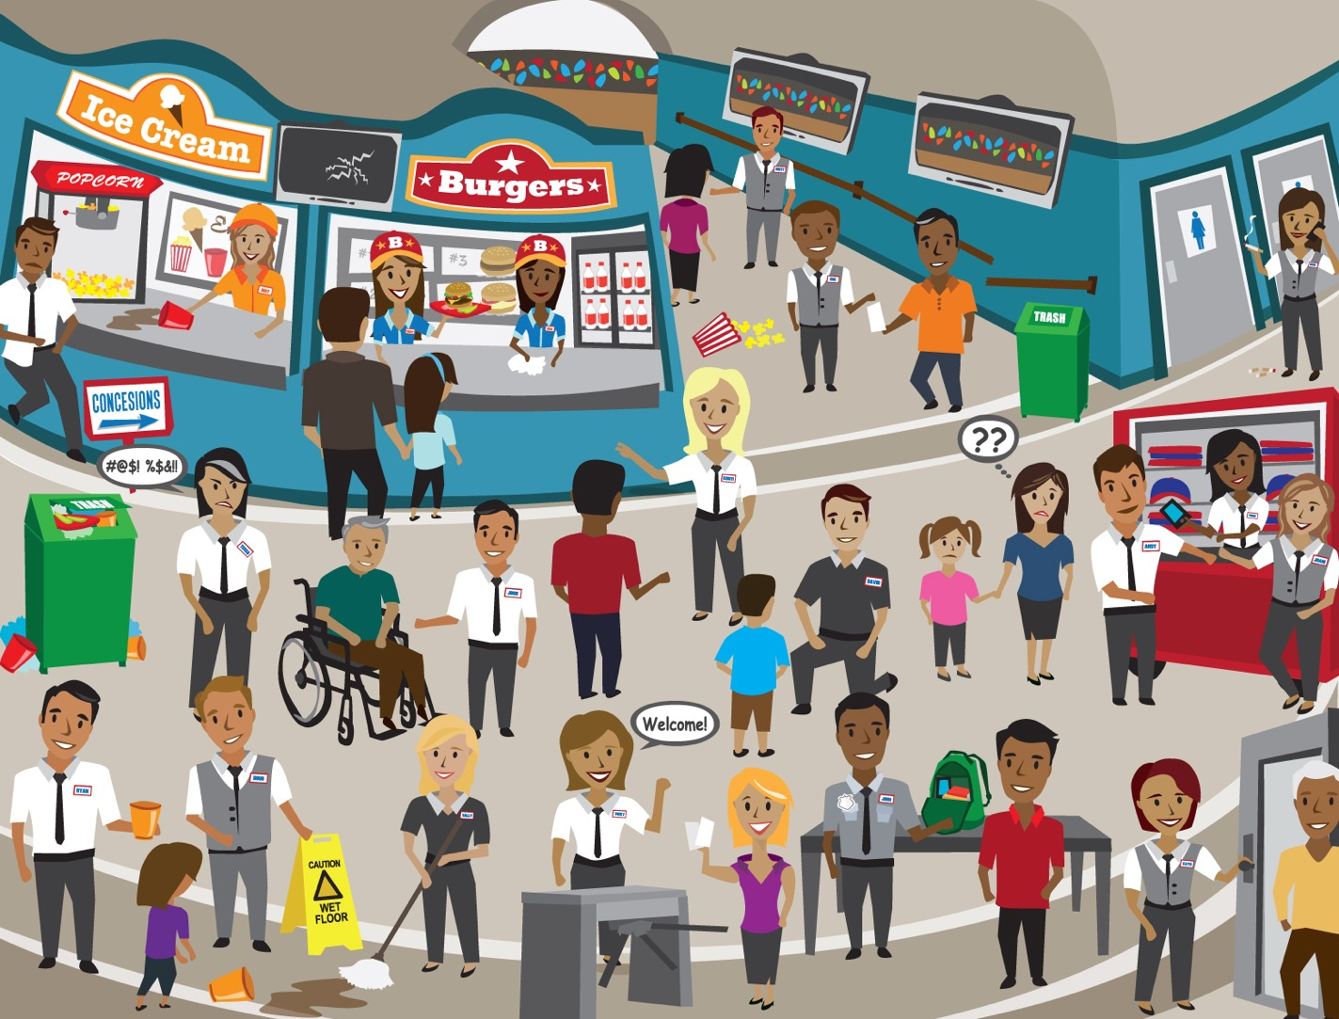
Activity: In bounds/out of bounds

Slide 45
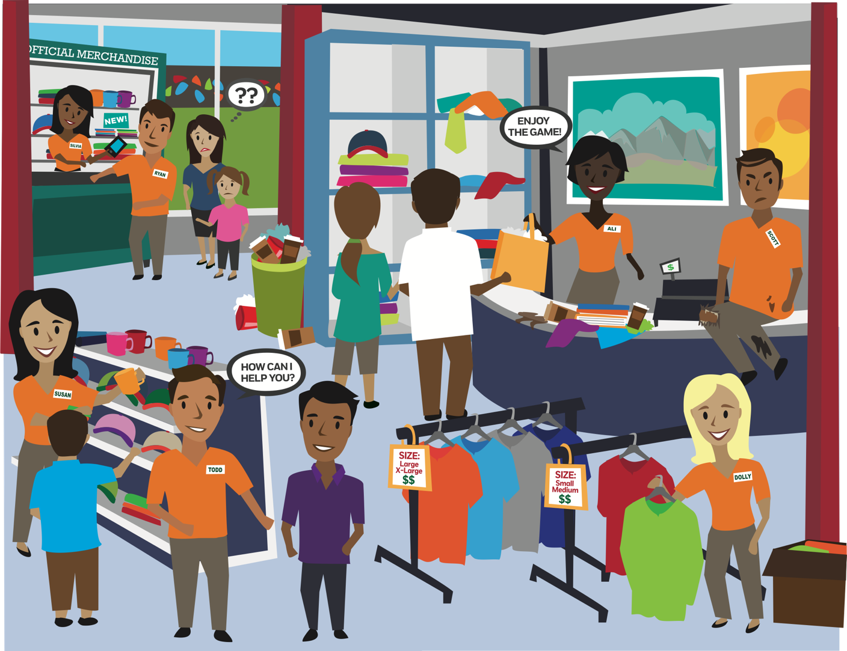
Activity: In bounds/out of bounds

Slide 46
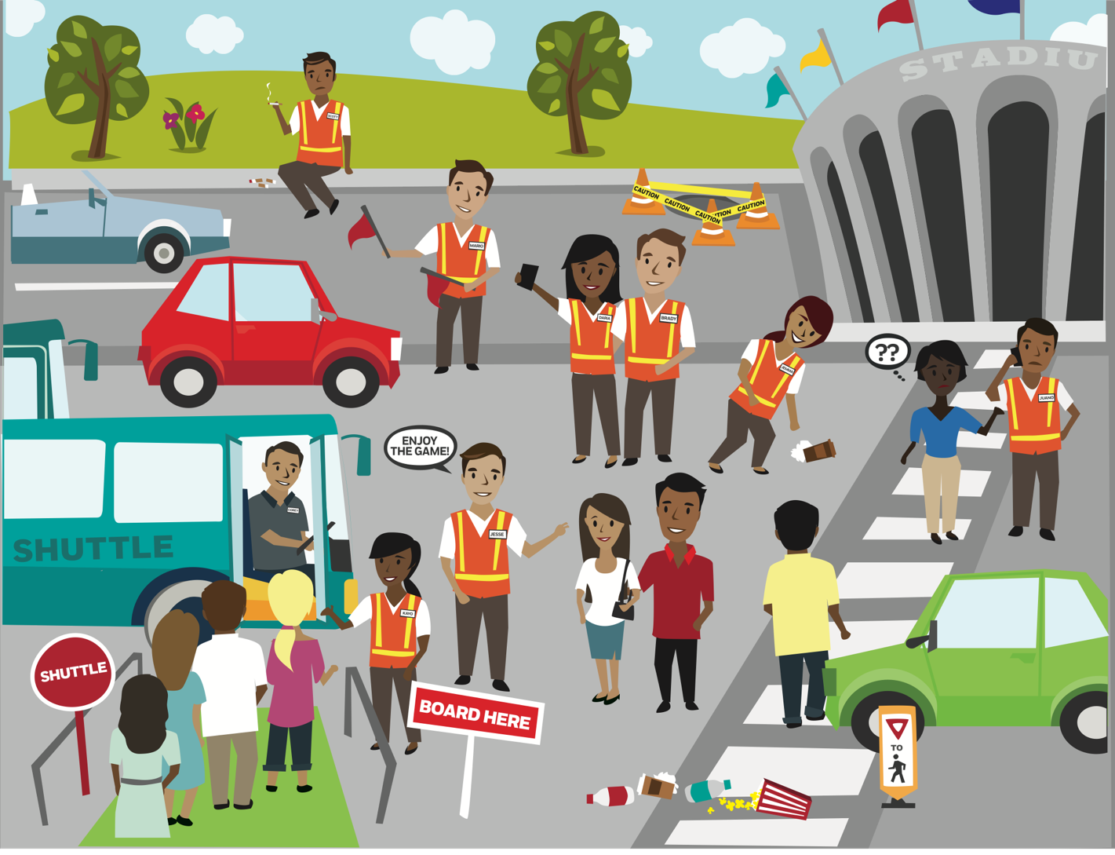
Activity: In bounds/out of bounds

Slide 47
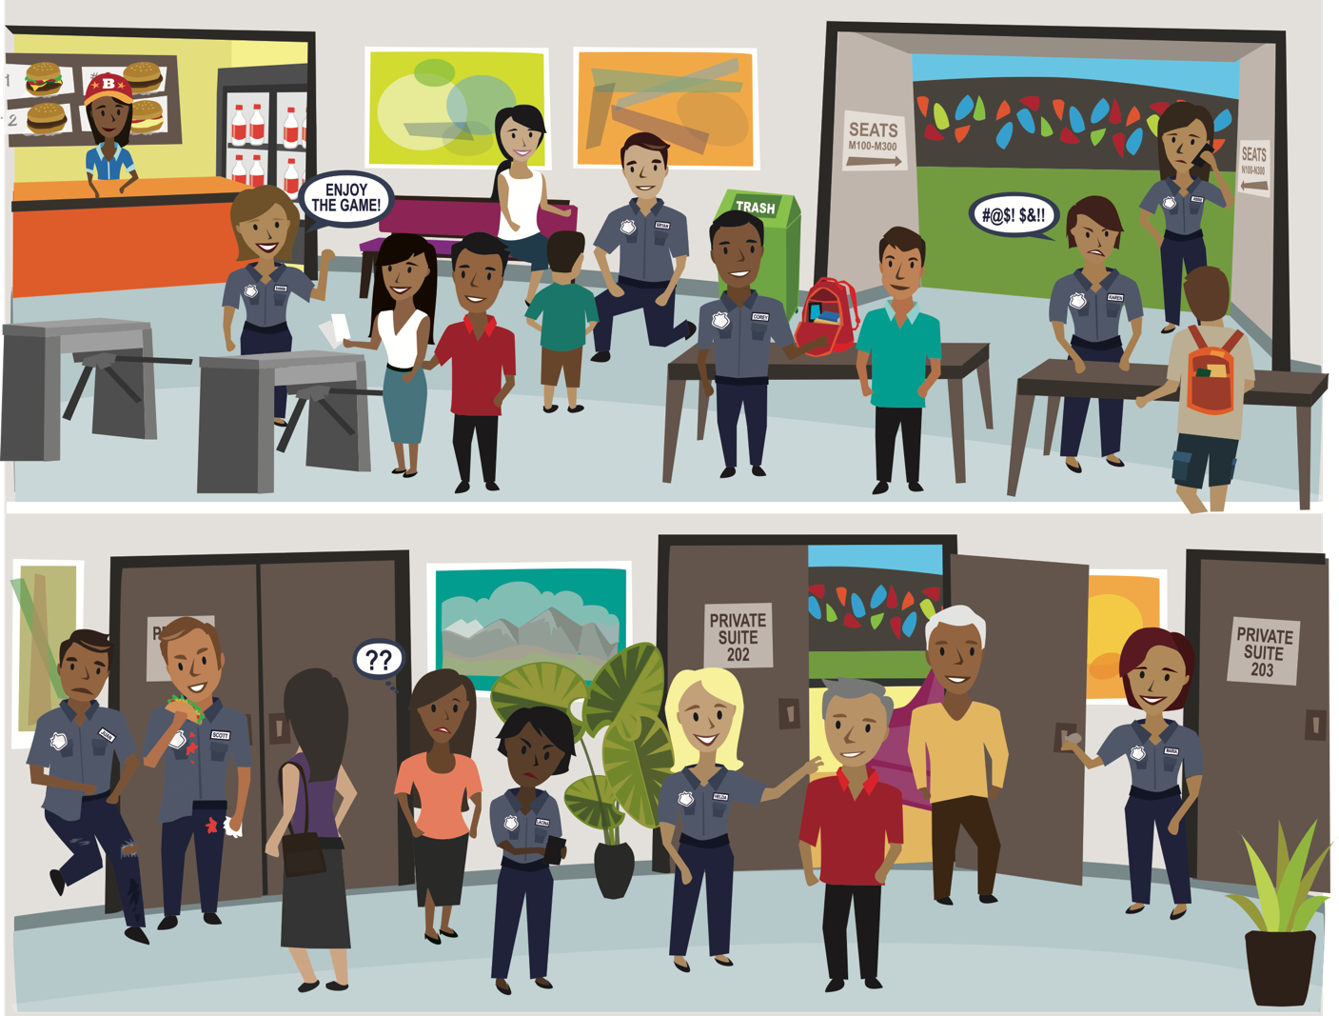
Activity: In bounds/out of bounds

Slide 48
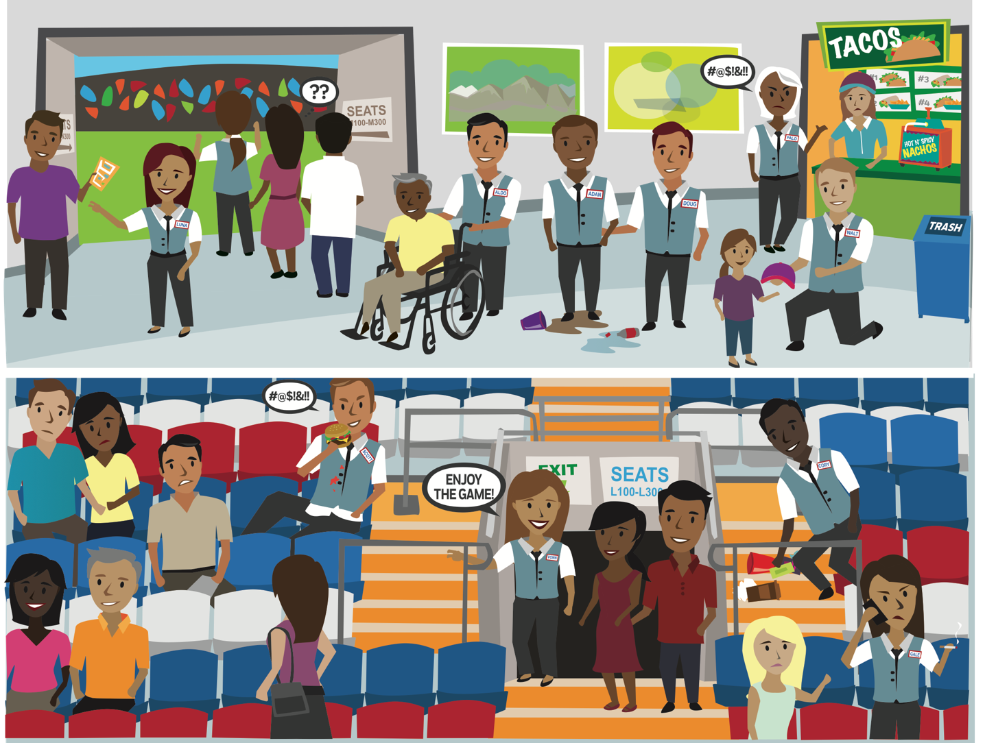
Activity: In bounds/out of bounds

Slide 49
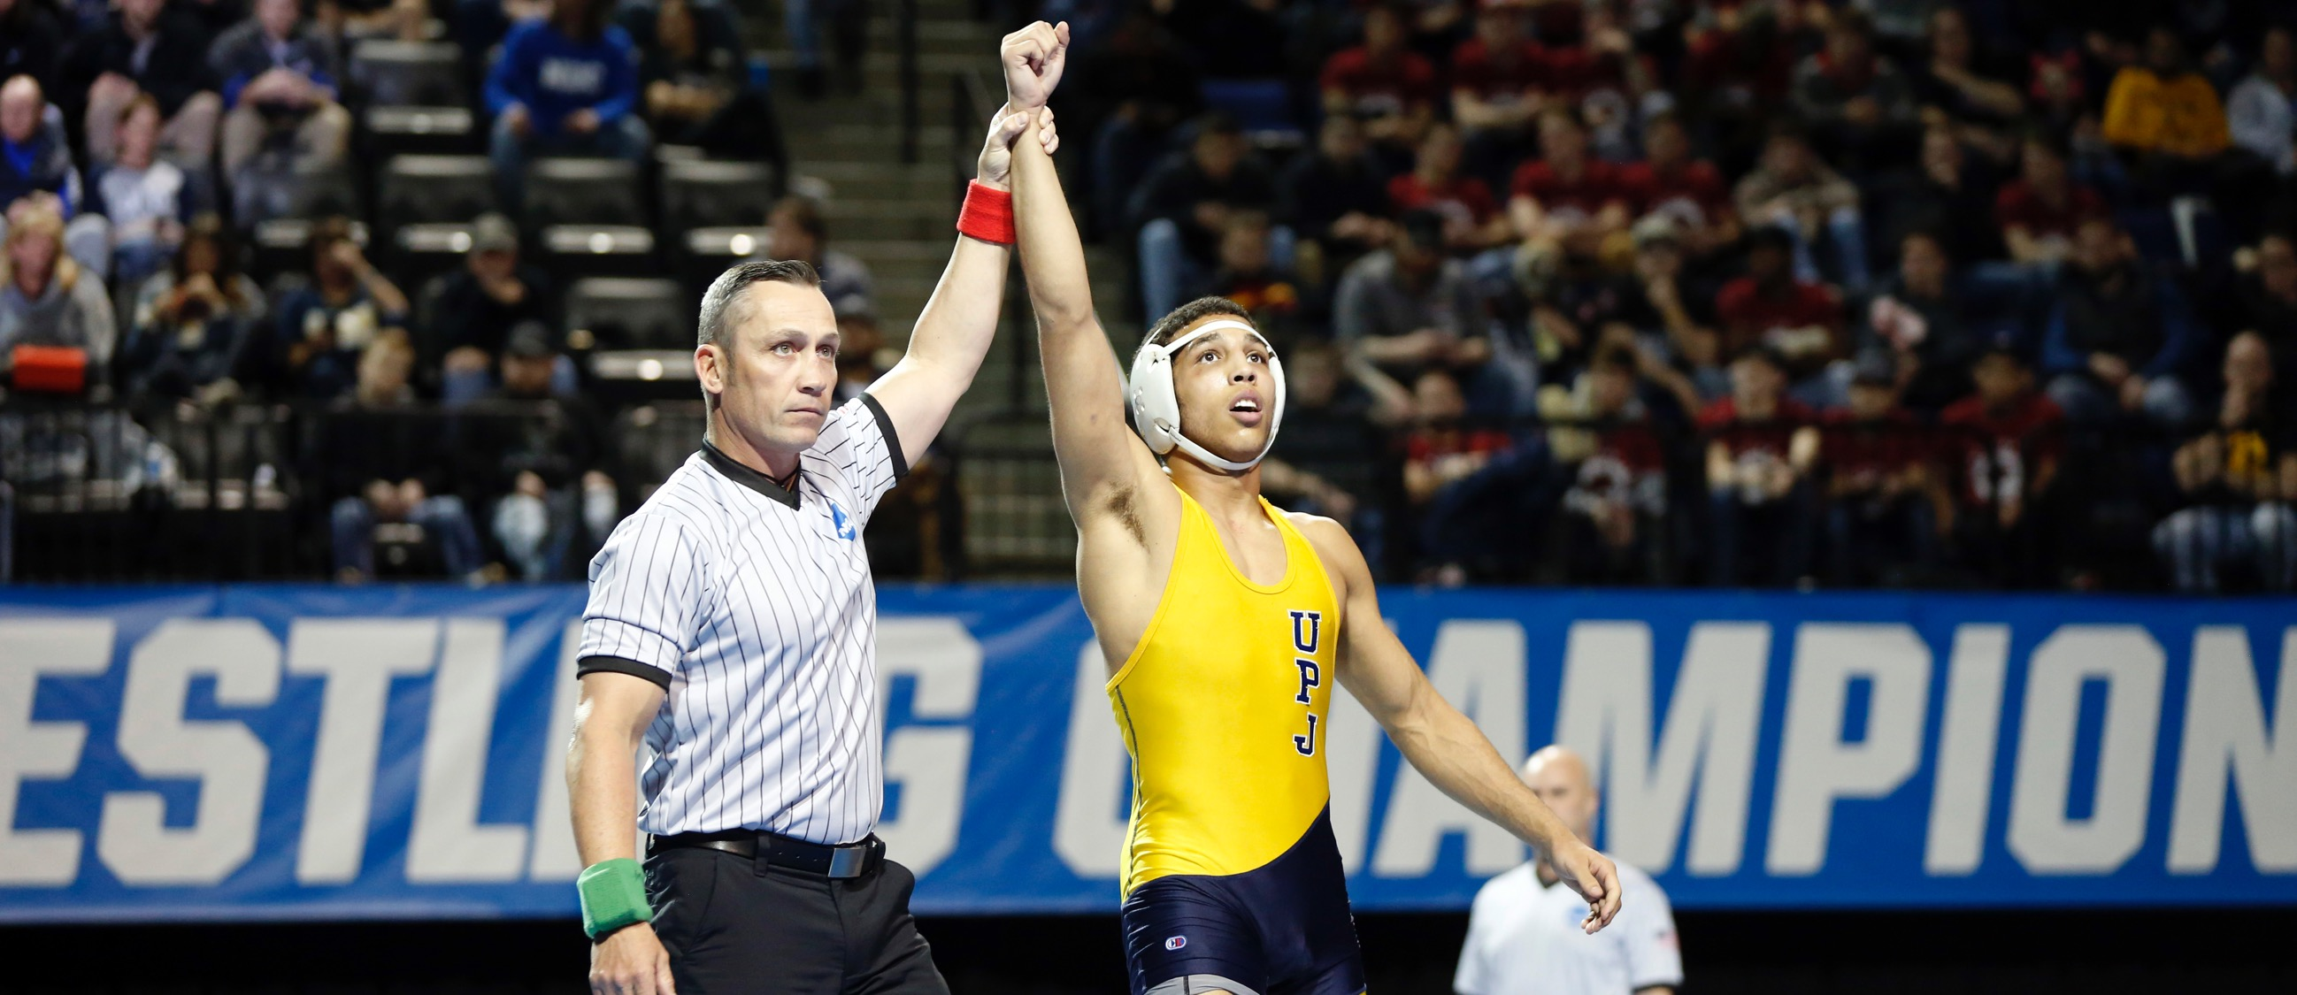
activity: REACH HIGHER
Notes:
2MIN

